Slide 1


An Introduction To
The WorkPlace Big Five Profile™
PARADIGM PERSONALITY LABS
May 24
Notes:
Use this presentation to help you as you give feedback sessions. You can hide or switch around slides as necessary for your purposes.
This slide deck can be used for individual or group feedback. We have added instructions for virtual feedback where possible.
We have provided a suggested script with each slide. You may modify to add from your experiences and to use examples that are relevant to your audience.

Slide 2

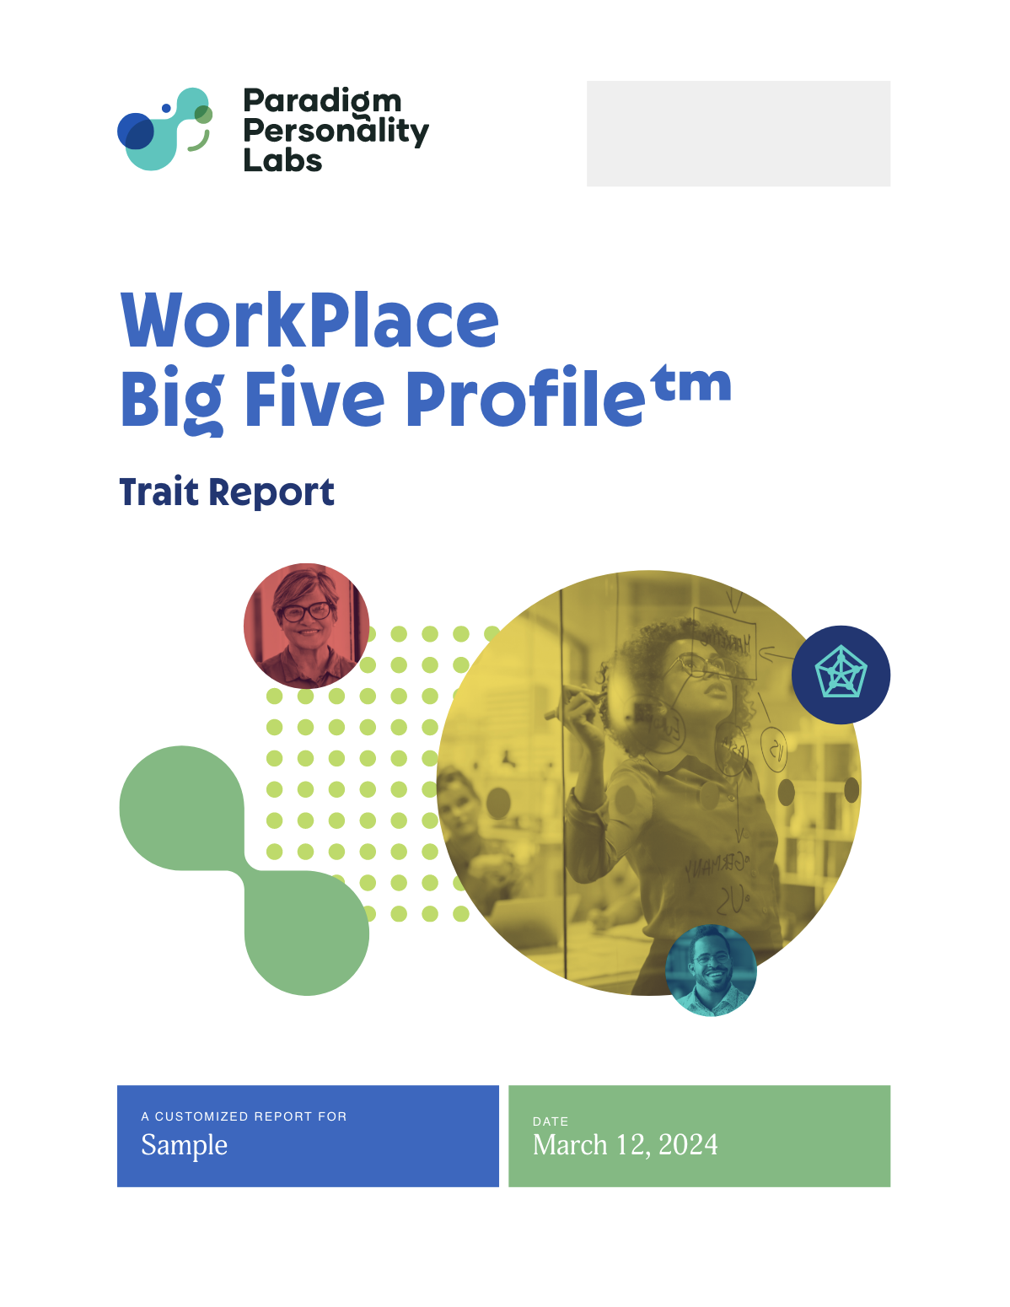
Objectives
Understand why personality matters at work and how it is measured in the Big Five Model
Learn about your individualized
WorkPlace Big Five Profile™ scores
Increase awareness of your
workplace behaviors
Apply the model to leverage your personality strengths and manage any perceived challenges
PARADIGM PERSONALITY LABS |
May 24
© PARADIGM PERSONALITY LABS. ALL RIGHTS RESERVED.

Slide 3





Paradigm & Personality
There is beauty and power in individuality.
PPL’s WorkPlace Big Five ProfileTM is a personality assessment framework to decode an individual’s unique personality footprint. Insights from the assessment are used to leverage individual strengths, manage challenges, and improve business outcomes.
There is no one right way to be.
May 24
PARADIGM PERSONALITY LABS |
© PARADIGM PERSONALITY LABS. ALL RIGHTS RESERVED.
Notes:
There is beauty and power in individuality.
Paradigm’s WorkPlace Big Five ProfileTM is a personality assessment framework to decode an individual’s unique personality footprint. Insights from the assessment are used to leverage individual strengths, manage challenges, and improve business outcomes.
There is no one right way to be.

Slide 4




Which workplace
tasks energize you?
May 24
PARADIGM PERSONALITY LABS |
© PARADIGM PERSONALITY LABS. ALL RIGHTS RESERVED.
Notes:
For groups, use polling such app such as Mentimeter: https://www.menti.com
Estimated time: 3 minutes
Instruct participants how to use pole and answer and then use the next slide to display the results in a word cloud.
Before we discuss your WorkPlace Big Five Profile reports, let’s take a couple of minutes to think about which workplace tasks and roles energize you most?

Slide 5

Energy Word Cloud
PARADIGM PERSONALITY LABS |
May 24
© PARADIGM PERSONALITY LABS. ALL RIGHTS RESERVED.
Notes:
NOTE: THIS SLIDE IS ONLY USEFUL FOR GROUPS. SKIP IF DOING A ONE-ON-ONE DEBRIEF
Estimated time: 4 minutes to build and display wordcloud
Embed Mentimeter word cloud here so that the answers are displayed on this slide.
-Review the results.
Why do you think I am asking this question?
Personality traits directly relate to your answers – which tasks and roles energize you at work. In fact, your choice of career and course of study also likely relate to your personality. We’ll build on this concept of energy as we go through your reports and help you to make meaning with them.

Slide 6
Personality Assessments:
What do they reveal?
Insights about behavioral tendencies and preferences, natural strengths, and blind spots
Does not tell what people actually do or how well they perform in a given situation
PARADIGM PERSONALITY LABS |
May 24
© PARADIGM PERSONALITY LABS. ALL RIGHTS RESERVED.
Notes:
Using your WorkPlace trait scores, we can discuss how your personality traits are displayed when you are at work, potentially helping you or hindering you with your daily work activities. It can also help you understand how alike or different you are to the personalities of other people you work with every day.
When we look at your results, we can discuss how your tendencies and preferences play out for you in the work setting.

Slide 7

? % Inherited
? % Environmental
and other elements
Personality:
Where does it
come from?
PARADIGM PERSONALITY LABS |
May 24
© PARADIGM PERSONALITY LABS. ALL RIGHTS RESERVED.
Notes:
Potential Activity for Virtual Group:
1) Present this slide WITHOUT the percentages. Create a poll question:
What percentage of personality is inherited (nature) and what percentage is environmental and other elements (nurture)?
2) Provide answer choices in a Zoom poll as follows:
“What is the current % breakdown between NATURE versus NURTURE that determine our personality traits?”
Nature 30% & Nurture 70%
Nature 50% & Nurture 50%
Nature 60% & Nurture 40%
Nature 70% & Nurture 30%
Zoom Instructions for Polling: https://support.zoom.us/hc/en-us/articles/213756303-Polling-for-Meetings
3) Share the results of the poll and move to the next slide.

Slide 8
40-60 % Inherited
40-60 % Environmental
and other elements
Personality:
Where does it
come from?
PARADIGM PERSONALITY LABS |
May 24
© PARADIGM PERSONALITY LABS. ALL RIGHTS RESERVED.
Notes:
Potential Activity for Virtual Group:
1) Present this slide WITHOUT the percentages. Create a poll question:
What percentage of personality is inherited (nature) and what percentage is environmental and other elements (nurture)?
2) Provide answer choices in a Zoom poll as follows:
“What is the current % breakdown between NATURE versus NURTURE that determine our personality traits?”
Nature 30% & Nurture 70%
Nature 50% & Nurture 50%
Nature 60% & Nurture 40%
Nature 70% & Nurture 30%
Zoom Instructions for Polling: https://support.zoom.us/hc/en-us/articles/213756303-Polling-for-Meetings
3) Share the results of the poll and move to the next slide.

Slide 9


Personality
Traits
Behaviors
PARADIGM PERSONALITY LABS |
May 24
© PARADIGM PERSONALITY LABS. ALL RIGHTS RESERVED.
Notes:
Personality is a large bucket, traits are a subset of that, and behaviors are a subset of traits
Personality is comprised of traits – there are 5 supertraits in the WorkPlace Big Five ProfileTM and 23 subtraits.
Traits are correlated sets of behaviors. For example, the WorkPlace subtrait, high Sociability that falls under the supertrait Extraversion, is expressed by behaviors such as:
-Enjoying meetings
-Talking (over listening)
-Informal group leadership
-Seeking out opportunities to connect with others
-Aversion to working completely alone
Not all highly social people look alike. Some might engage in all of these behaviors, others a subset. We each have our own unique personality footprint.

Slide 10




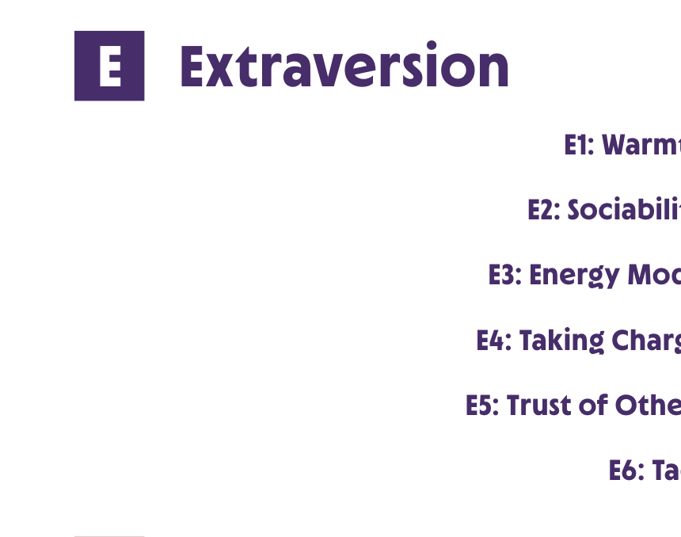
WorkPlace Big Five Profile™ Supertraits
Need For Stability
Originality
Consolidation
Accommodation
Extraversion
PARADIGM PERSONALITY LABS |
May 24
© PARADIGM PERSONALITY LABS. ALL RIGHTS RESERVED.
Notes:
These are the Big Five supertraits. Each supertrait is a lens to explain individual differences. Each of the Five supertraits additionally has 3-6 subtraits that are distinct ways to explain a particular aspect of that supertrait.
We will discuss each supertrait in more detail, as well as your scores.

Slide 11
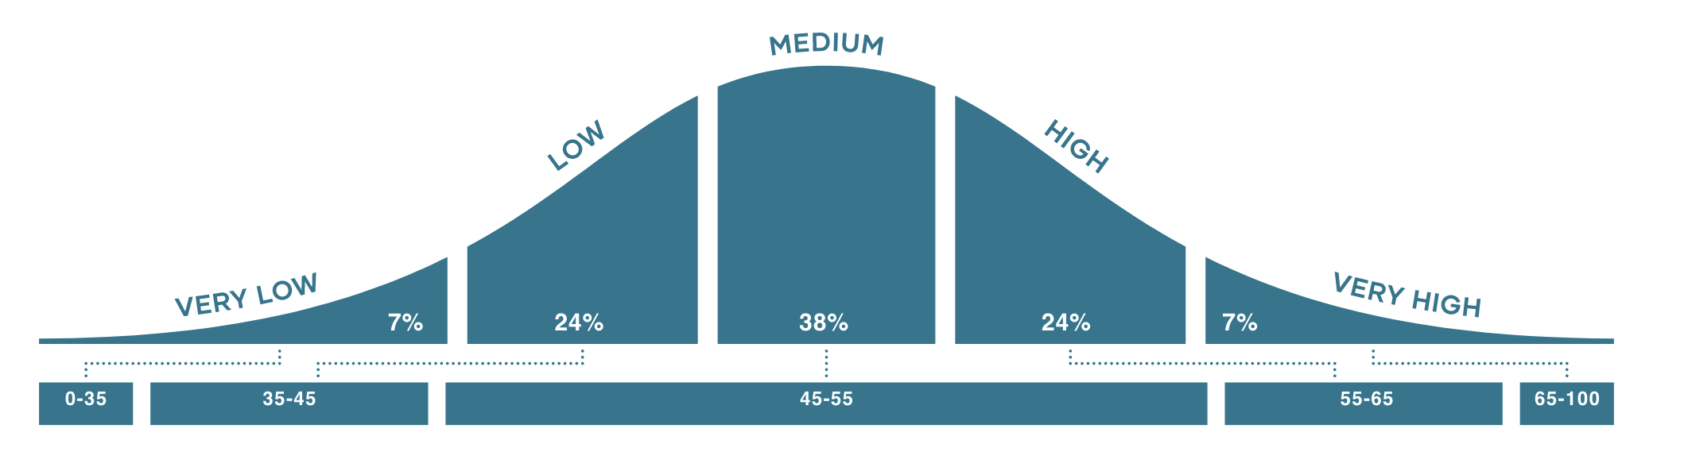
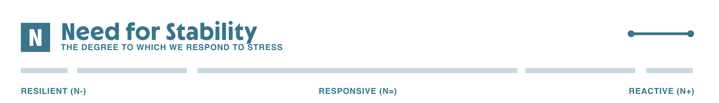
WorkPlace Big Five Profile™ Continuum
PARADIGM PERSONALITY LABS |
May 24
© PARADIGM PERSONALITY LABS. ALL RIGHTS RESERVED.
Notes:
The WorkPlace Big Five Profile™ displays your trait information on the 5 supertraits and 23 subtraits. Each trait is represented on its own scale or continuum. Your score on each continuum is between 0 and 100. There are no good or bad scores on the WorkPlace assessment. Every score is valid and has the potential to help us in some way with our jobs as well as pose challenges for us.
Why is it important to show you the “dreaded” bell curve? Because your score on any given trait indicates where you tend to behave relative to others in a norm group that is comprised of a working population in your geography. Personality is naturally normally distributed such that scores cluster toward the middle range.
We will be talking scores primarily according to three ranges:
Low: 0-44
Medium: 45-55
High: 56-100
People with scores in the Very Low (0-35) and Very High (65-100) ranges will tend to demonstrate more characteristics and behaviors that are associated with the endpoints.
--------------------------------------------------------------------
If you’d like more detailed text for your audience, you can add this:
[[[Of the people in the norm population for the assessment, 38% score in the middle range of each scale, with scores between 45 and 55. Lower-range scores are between 0 and 44 while higher range scores are between 56 and 100.
What I want you to remember from this example is that when we have a continuum, as we will have when we look at the five factors of the Big Five, we will see clear end points. As we move away from those end points, we will have combinations of traits from both ends of the continuum.
The closer a person scores toward the end points of the scale, the more that person will tend to demonstrate characteristics and behaviors that are associated with the end points.
At the same time, someone who scores in the middle of a scale is likely to use a combination of characteristics and behaviors, alternating them according to the situation.]]]

Slide 12
Your
WorkPlace Big Five Profile™ Trait Report
PARADIGM PERSONALITY LABS |
May 24
© PARADIGM PERSONALITY LABS. ALL RIGHTS RESERVED.
Notes:
Now let’s see your actual scores on the five supertraits. Please open to page 4 of the WorkPlace Big Five Profile™ Trait report. You’ll have time to read the introductory sections on your own after this debrief.
Let’s compare these scores to the estimates you provided. If you find differences in the scores you estimated from those in your report, make a note. By the end of this session, you’ll have a good understanding of the traits and how they relate to your behaviors at work. In almost all cases, this resolves the initial difference you noted.
Sometimes we think that our personalities are hidden from others. That is very rarely true. People who work with us or live with us day in and day out can probably identify distinctive parts of our personalities without even thinking about them.
If you find yourself worrying about your results, remember that there is no one right way to be because as Ralph Waldo Emerson said, “Every individual nature has its own beauty.”

Slide 13
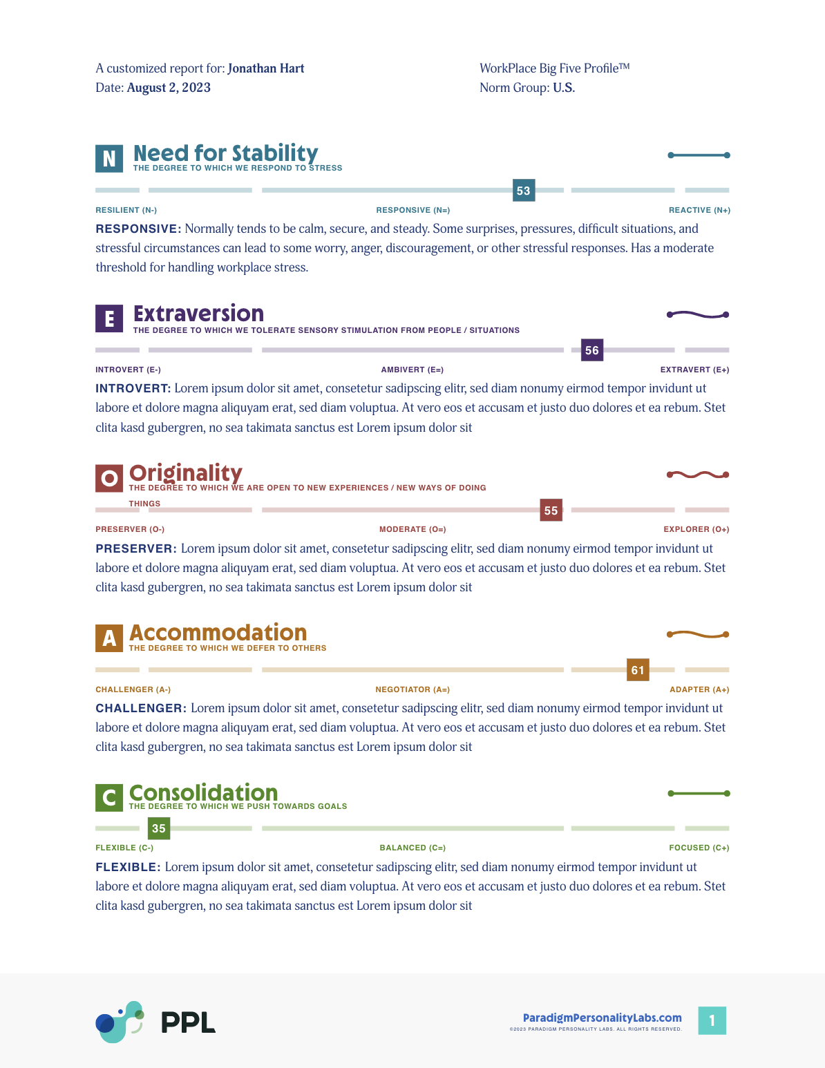
WorkPlace Big Five Profile™
Trait Report
Page 4
The 5 supertraits
Note: Only text that relates to your individual scores appears on this page
PARADIGM PERSONALITY LABS |
May 24
© PARADIGM PERSONALITY LABS. ALL RIGHTS RESERVED.
Notes:
Now let’s see your actual scores on the five supertraits. Please open to page 4 of the WorkPlace Big Five Profile™ Trait report. You’ll have time to read the introductory sections on your own after this debrief.
Let’s compare these scores to the estimates you provided. If you find differences in the scores you estimated from those in your report, make a note. By the end of this session, you’ll have a good understanding of the traits and how they relate to your behaviors at work. In almost all cases, this resolves the initial difference you noted.
Sometimes we think that our personalities are hidden from others. That is very rarely true. People who work with us or live with us day in and day out can probably identify distinctive parts of our personalities without even thinking about them.
If you find yourself worrying about your results, remember that there is no one right way to be because as Ralph Waldo Emerson said, “Every individual nature has its own beauty.”

Slide 14
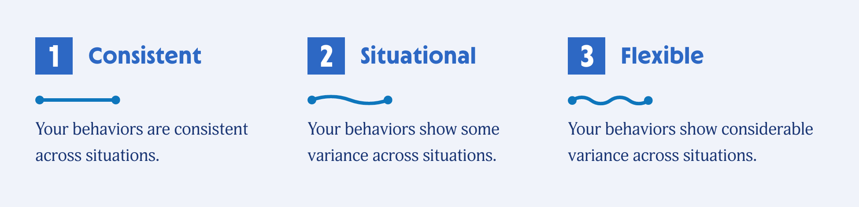
Context Matters
Trait Variance
PARADIGM PERSONALITY LABS |
May 24
© PARADIGM PERSONALITY LABS. ALL RIGHTS RESERVED.
Notes:
You’ll notice from page 4 of your Trait report that there are little green lines to the right above the trait continuum. This is what we refer to as Trait Variance.
We add in another layer of understanding with Trait Variance. This describes the degree to which your behaviors are consistent or somewhat flexible according to context. For example, you may take a more perfectionistic approach on projects you find more interesting or important. It’s neither good nor bad. Rather, it is helpful to think about situational and flexible scores so and how those variances in a particular score may play out for you in subtraits with trait variance. You can read more about this in your report.

Slide 15



N1: Worry
How to use the Trait and Subtrait slides
N
E
O
A
C
Need For Stability
THE DEGREE TO WHICH WE RESPOND TO STRESS
Clicking on the Trait letter will take you to that Trait’s slides
RESILIENT (N-)
RESPONSIVE (N=)
REACTIVE (N+)
Low: 0-44
Moderate: 45-55
High: 56-100
Clicking on a Subtrait button will take you to the respective slides
Subtraits
N1: Worry
N2: Intensity
N3: Interpretation
N4: Rebound Time
at ease <--> very concerned
LOW WORRY: 0-44
MODERATE WORRY: 45-55
HIGH WORRY: 56-100
N1: Worry
Is it relatively natural and easy for you to stay calm and worry-free?
©2024 PARADIGM PERSONALITY LABS. ALL RIGHTS RESERVED.
Notes:
How to use the hot button features on the following slides to create a seamless experience for your participant/s.
You can also refer to the Debrief Presentation Notes in the My Paradigm Dashboard Practitioner Toolbox.
Practitioner’s also like to review the WorkPlace Big Five ProfileTM Trait Definitions document to prepare for debrief. You’ll find this document in the Practitioner Toolbox as well.

Slide 16
About Supertrait Descriptions
A thumbs-up description refers to the highest, most self-aware behaviors associated with a trait range.
A thumbs-down description refers to less desirable or supportive behaviors associated with the trait range.
PARADIGM PERSONALITY LABS |
May 24
© PARADIGM PERSONALITY LABS. ALL RIGHTS RESERVED.
Notes:
As we review behaviors associated with the WorkPlace Big Five Profile supertraits, we will see examples grouped according to "thumbs up" and "thumbs down".
[Review the information on the slide.]
We all have times when stress, pressure, life events, or simply “a bad day” prompt less desirable behavioral expressions of traits. Sometimes, it is from lack of self-awareness.

Slide 17
E
O
A
C
Need For Stability
THE DEGREE TO WHICH WE RESPOND TO STRESS
RESILIENT (N-)
RESPONSIVE (N=)
REACTIVE (N+)
Low: 0-44
Moderate: 45-55
High: 56-100
Cool, rational, at ease
Shows concern as needed
Alert, expressive, high sense of urgency
Lack concern, low sense
of urgency
Level of concern may not match business need
Rumination, difficulty down-regulating stress response
Subtraits
N1: Worry
N2: Intensity
N3: Interpretation
N4: Rebound Time
Notes:
N (Need for Stability) deals with stress. Stress occurs when you decide that something (called a stressor) has come between you and one of your goals. Your score on N is an estimate of the magnitude of obstacle necessary for you to interpret it as a stressor.
Biological basis:
Arousal system: autonomic nervous system; “fight or flight”
Stimulus: stress
This table shows descriptors for behaviors (expression of the trait) in their most desirable and least desirable forms for low, medium, and high scores. Whether someone’s behaviors at any given time fall into “desirable” or “undesirable” forms is dependent on context, general level of self-awareness, and trait energy (which we will describe after the Supertraits).
Lower scorers – Resilients - have less need for stability; unstable situations do not particularly stress them. They have more capacity for calmness with occasional reactivity.
Mid-range scorers – Responsives - tend to be calm, secure, and steady under normal circumstances. However, some surprises, pressures, emergencies, difficult situations, and stressful circumstances can lead to occasional worry, anger, discouragement, or other types of stressful responses.
High scorers – Reactives - have a greater need for stability because even slightly unstable situations generate stress. They have more tendency to react across situations, with their calmness being easily displaced.
The opposing tendencies are calmness and reactivity.

Slide 18
N1: Worry
N
E
O
A
C
Need For Stability
THE DEGREE TO WHICH WE RESPOND TO STRESS
RESILIENT (N-)
RESPONSIVE (N=)
REACTIVE (N+)
Low: 0-44
Moderate: 45-55
High: 56-100
Subtraits
N1: Worry
N2: Intensity
N3: Interpretation
N4: Rebound Time
at ease <--> very concerned
Low Worry: 0-44
Moderate Worry: 45-55
High Worry: 56-100
N1: Worry
Is it relatively natural and easy for you to stay calm and worry-free?
©2024 PARADIGM PERSONALITY LABS. ALL RIGHTS RESERVED.
Notes:
Please look at pages 5 and 6 in your report.
Need for Stability (N) Subtraits
N1: Worry.
This subtrait is concerned with the amount we worry in general; about whether we or those important to us will be served in our or their best interests and how quickly we move into a worried state.
The opposing tendencies are at ease and very concerned.
Lower scorers: cool, rational, lacking concern
tend to be at ease most of the time and maintain a cool, rational stance even in the face of crisis or emergency. They might not address situations with a sense of urgency and seriousness that higher scorers would deem appropriate.

Slide 19
N1: Worry
N
E
O
A
C
Need For Stability
THE DEGREE TO WHICH WE RESPOND TO STRESS
RESILIENT (N-)
RESPONSIVE (N=)
REACTIVE (N+)
Low: 0-44
Moderate: 45-55
High: 56-100
Subtraits
N1: Worry
N2: Intensity
N3: Interpretation
N4: Rebound Time
at ease <--> very concerned
Low Worry: 0-44
Moderate Worry: 45-55
High Worry: 56-100
N1: Worry
Or do you tend to worry about outcomes and things that are important to you to the point that interferes with your sleep?
©2024 PARADIGM PERSONALITY LABS. ALL RIGHTS RESERVED.
Notes:
High scorers: prone to rumination, alert, expressive, nervous edge
People with this score range tend to expend more of their time and energy in a worried state. They may develop a nervous edge, particularly when the outcomes are in doubt.

Slide 20
N1: Worry
N
E
O
A
C
Need For Stability
THE DEGREE TO WHICH WE RESPOND TO STRESS
RESILIENT (N-)
RESPONSIVE (N=)
REACTIVE (N+)
Low: 0-44
Moderate: 45-55
High: 56-100
Subtraits
N1: Worry
N2: Intensity
N3: Interpretation
N4: Rebound Time
at ease <--> very concerned
Low Worry: 0-44
Moderate Worry: 45-55
High Worry: 56-100
N1: Worry
Or are you somewhere in between?
©2024 PARADIGM PERSONALITY LABS. ALL RIGHTS RESERVED.
Notes:
Mid-range scorers: people moderate or moderate, situational in Worry could either hold a moderate amount of worry consistently or vary between being concerned about some matters and relatively unconcerned about others.

Slide 21
N1: Worry
N
E
O
A
C
Need For Stability
THE DEGREE TO WHICH WE RESPOND TO STRESS
RESILIENT (N-)
RESPONSIVE (N=)
REACTIVE (N+)
Low: 0-44
Moderate: 45-55
High: 56-100
Subtraits
N1: Worry
N2: Intensity
N1: Worry
N2: Intensity
N3: Interpretation
N4: Rebound Time
calm <--> impassioned
Low Intensity: 0-44
Moderate Intensity: 45-55
High Intensity: 56-100
N2: Intensity
Do you tend to be very calm and usually not prone to feelings of anger?
©2024 PARADIGM PERSONALITY LABS. ALL RIGHTS RESERVED.
Notes:
N2: Intensity.
This subtrait is about the degree to which people both respond to insult and have or display impassioned feelings.
The opposing tendencies are calm and impassioned.
Lower scorers: composure, calm, tend to remain calm and cool during conflict or disagreement and keep their composure even under personal attack.

Slide 22
N1: Worry
N
E
O
A
C
Need For Stability
THE DEGREE TO WHICH WE RESPOND TO STRESS
RESILIENT (N-)
RESPONSIVE (N=)
REACTIVE (N+)
Low: 0-44
Moderate: 45-55
High: 56-100
Subtraits
N1: Worry
N2: Intensity
N1: Worry
N2: Intensity
N3: Interpretation
N4: Rebound Time
calm <--> impassioned
Low Intensity: 0-44
Moderate Intensity: 45-55
High Intensity: 56-100
N2: Intensity
Or do you tend to experience anger and other impassioned emotions with regularity?
©2024 PARADIGM PERSONALITY LABS. ALL RIGHTS RESERVED.
Notes:
Higher scorers tend to feel heated or impassioned during conflict or disagreement, or when they or people important to them are insulted or mistreated. They often serve as a barometer for justice and fair play.

Slide 23
N1: Worry
N
E
O
A
C
Need For Stability
THE DEGREE TO WHICH WE RESPOND TO STRESS
RESILIENT (N-)
RESPONSIVE (N=)
REACTIVE (N+)
Low: 0-44
Moderate: 45-55
High: 56-100
Subtraits
N1: Worry
N2: Intensity
N1: Worry
N2: Intensity
N3: Interpretation
N4: Rebound Time
calm <--> impassioned
Low Intensity: 0-44
Moderate Intensity: 45-55
High Intensity: 56-100
N2: Intensity
Or are you somewhere in between?
©2024 PARADIGM PERSONALITY LABS. ALL RIGHTS RESERVED.
Notes:
Mid-range scorers are either moderate in their Intensity or maintain a balance between being cool part of the time and impassioned at other times.

Slide 24
N1: Worry
N
E
O
A
C
Need For Stability
THE DEGREE TO WHICH WE RESPOND TO STRESS
RESILIENT (N-)
RESPONSIVE (N=)
REACTIVE (N+)
Low: 0-44
Moderate: 45-55
High: 56-100
Subtraits
N1: Worry
N1: Worry
N2: Intensity
N3: Interpretation
N4: Rebound Time
N3: Interpretation
confidence <--> doubt
Low Interpretation: 0-44
Moderate Interpretation: 45-55
High Interpretation: 56-100
N3: Interpretation
Do you tend to feel confident that you can succeed and overcome obstacles?
©2024 PARADIGM PERSONALITY LABS. ALL RIGHTS RESERVED.
Notes:
N3: Interpretation.
Interpretation describes how our personal confidence plays out at work. This is about our personal mindset, our perceived ability to positively shape outcomes. This is different from a more global a mindset of optimism or pessimism.
The opposing tendencies are confidence and doubt.
Lower scorers tend to believe that things will work out in most situations. They tend to also have a form of optimism that manifests as personal confidence in one’s ability to succeed or overcome hurdles and to get “back in the ring” and try again after defeat.

Slide 25
N1: Worry
N
E
O
A
C
Need For Stability
THE DEGREE TO WHICH WE RESPOND TO STRESS
RESILIENT (N-)
RESPONSIVE (N=)
REACTIVE (N+)
Low: 0-44
Moderate: 45-55
High: 56-100
Subtraits
N1: Worry
N1: Worry
N2: Intensity
N3: Interpretation
N4: Rebound Time
N3: Interpretation
confidence <--> doubt
Low Interpretation: 0-44
Moderate Interpretation: 45-55
High Interpretation: 56-100
N3: Interpretation
Or do you find yourself feeling a sense of failure and discouragement when things seem difficult?
©2024 PARADIGM PERSONALITY LABS. ALL RIGHTS RESERVED.
Notes:
Higher scorers tend to anticipate problems more readily and take the blame for their own or others' failure. They are likely to experience feelings of self-doubt or discouragement when in difficult situations.

Slide 26
N1: Worry
N
E
O
A
C
Need For Stability
THE DEGREE TO WHICH WE RESPOND TO STRESS
RESILIENT (N-)
RESPONSIVE (N=)
REACTIVE (N+)
Low: 0-44
Moderate: 45-55
High: 56-100
Subtraits
N1: Worry
N1: Worry
N2: Intensity
N3: Interpretation
N4: Rebound Time
N3: Interpretation
confidence <--> doubt
Low Interpretation: 0-44
Moderate Interpretation: 45-55
High Interpretation: 56-100
N3: Interpretation
Or are you somewhere in between?
©2024 PARADIGM PERSONALITY LABS. ALL RIGHTS RESERVED.
Notes:
Mid-range scorers tend to interpret situations more realistically, thinking that they can positively impact some situations while possessing less confidence in others.

Slide 27
N1: Worry
N
E
O
A
C
Need For Stability
THE DEGREE TO WHICH WE RESPOND TO STRESS
RESILIENT (N-)
RESPONSIVE (N=)
REACTIVE (N+)
Low: 0-44
Moderate: 45-55
High: 56-100
Subtraits
N1: Worry
N1: Worry
N2: Intensity
N3: Interpretation
N4: Rebound Time
N4: Rebound Time
bouncing back <--> slower to recover
Low Rebound Time: 0-44
Moderate Rebound Time: 45-55
High Rebound Time: 56-100
N4: Rebound Time
Do you bounce into action in crises and stressful situations?
©2024 PARADIGM PERSONALITY LABS. ALL RIGHTS RESERVED.
Notes:
N4: Rebound Time.
This subtrait is about the amount of time we require to recover from a crisis or setback. It is often referred to as resilience or bouncing back.
The opposing tendencies here are bouncing back and slower to recover.
Lower scorers tend to react in stressful events quickly by orienting towards action steps to mitigate and recover.

Slide 28
N1: Worry
N
E
O
A
C
Need For Stability
THE DEGREE TO WHICH WE RESPOND TO STRESS
RESILIENT (N-)
RESPONSIVE (N=)
REACTIVE (N+)
Low: 0-44
Moderate: 45-55
High: 56-100
Subtraits
N1: Worry
N1: Worry
N2: Intensity
N3: Interpretation
N4: Rebound Time
N4: Rebound Time
bouncing back <--> slower to recover
Low Rebound Time: 0-44
Moderate Rebound Time: 45-55
High Rebound Time: 56-100
N4: Rebound Time
Or do you take time to process the situation and revisit it after resolution?
©2024 PARADIGM PERSONALITY LABS. ALL RIGHTS RESERVED.
Notes:
Higher scores may need time to regroup and emotional process after a failure, setback, or emergency. Afterwards, they are likely to reflect on lessons learned.

Slide 29
N1: Worry
N
E
O
A
C
Need For Stability
THE DEGREE TO WHICH WE RESPOND TO STRESS
RESILIENT (N-)
RESPONSIVE (N=)
REACTIVE (N+)
Low: 0-44
Moderate: 45-55
High: 56-100
Subtraits
N1: Worry
N1: Worry
N2: Intensity
N3: Interpretation
N4: Rebound Time
N4: Rebound Time
bouncing back <--> slower to recover
Low Rebound Time: 0-44
Moderate Rebound Time: 45-55
High Rebound Time: 56-100
N4: Rebound Time
Or are you somewhere in between?
©2024 PARADIGM PERSONALITY LABS. ALL RIGHTS RESERVED.
Notes:
Mid-range scorers usually need a little more time to recover, or they may approach problem-solving quickly in one type of situation and more slowly in another situation.
.

Slide 30

Extraversion
N
E
O
A
C
Extraversion
THE DEGREE TO WHICH WE TOLERATE SENSORY STIMULATION FROM PEOPLE/SITUATIONS
INTROVERT (E-)
AMBIVERT (E=)
EXTRAVERT (E+)
Low: 0-44
Moderate: 45-55
High: 56-100
Quiet, works well independently, reflective, allows space and time for others to participate, little need for “spotlight”
Shifts easily from working with others to working alone, acts as a moderating force in groups
Enthusiastic, shares emotions, people-oriented, comfortable with a lot of “action”, high energy
Loner, enigmatic, low energy, avoids taking charge of leading others, cool and aloof
Under communicates and resists taking charge, unable to be a “people person” for sustained periods of time
Overbearing, center-of-attention, outspoken to the point of dominating conversation
Subtraits
E1: Warmth
E2: Sociability
E3: Energy Mode
E4: Taking Charge
E5: Trust of Others
E6: Tact
Notes:
E(Extraversion) deals with sensory stimulation. Your score on E is an estimate of the sensory stimulation—noise, bright lights, colors, smells, and touch—you can take before you need to switch to being still and quiet. Extraversion is often equated with the desire to be around other people and introversion with the desire to be alone. However, this emphasis is inadequate since sensory stimulation naturally occurs where two or more people are gathered, but it can come from other sources, too.
Biological basis:
Arousal system: motoric nervous system
Stimulus: sensation/the five senses
If you are on the lower end of the E continuum – an Introvert - you tend to prefer working alone with very little sensory stimulation. You may gravitate toward solitary projects or those that involve small teams and tend to derive energy from more solitary and quieter pursuits.
If you are in the mid-range of the E continuum, – an Ambivert - you tend to move easily from working with other people to working alone. Ambiverts tend to have a moderate threshold for sensory stimulation. If you must be in an environment with people all the time or work exclusively alone, you will probably find either extremely dissatisfying.
If you are an Extravert – on the high end of the continuum – you likely feel most energized where your senses can be stimulated. Trade shows, meetings, business socials, concerts, and sporting events tend to give Extraverts the high sensory experience they enjoy. An Extraverts natural style, generally, is to be talkative, enthusiastic, sociable, warm, people-oriented, and fun-loving.
The opposing tendencies here are quiet and loud.

Slide 31
E1: Warmth
N
E
O
A
C
Extraversion
THE DEGREE TO WHICH WE TOLERATE SENSORY STIMULATION FROM PEOPLE/SITUATIONS
INTROVERT (E-)
AMBIVERT (E=)
EXTRAVERT (E+)
Low: 0-44
Moderate: 45-55
High: 56-100
Subtraits
E1: Warmth
E2: Sociability
E3: Energy Mode
E4: Taking Charge
E5: Trust of Others
E6: Tact
cool <--> warm
Low Warmth: 0-44
Moderate Warmth: 45-55
High Warmth: 56-100
E1: Warmth
Would your colleagues say that you tend to be cooler in interactions?
Notes:
Please look at pages 7, 8 and 9 in your report.
Extraversion (E) Subtraits
E1: Warmth.
This subtrait deals with the expression of positive emotions.
The opposing tendencies here are cool and warm.
Lower scorers tend to be hard to read in the sense that they reveal little of what they feel, either verbally or nonverbally. They tend to be more tight-lipped and find it easier to keep confidences, making them more likely to protect confidential information.

Slide 32
E1: Warmth
N
E
O
A
C
Extraversion
THE DEGREE TO WHICH WE TOLERATE SENSORY STIMULATION FROM PEOPLE/SITUATIONS
INTROVERT (E-)
AMBIVERT (E=)
EXTRAVERT (E+)
Low: 0-44
Moderate: 45-55
High: 56-100
Subtraits
E1: Warmth
E2: Sociability
E3: Energy Mode
E4: Taking Charge
E5: Trust of Others
E6: Tact
cool <--> warm
Low Warmth: 0-44
Moderate Warmth: 45-55
High Warmth: 56-100
E1: Warmth
Or that you are naturally warm and effusive?
Notes:
Higher scorers tend to express positive feelings to others. They find it easy to display positive emotions and create a warm relational space. They tend to easily fall into chitchat with co-workers and typically share much personal information (both about work and private life) with their work associates. They are more likely to have coworkers as personal friends.

Slide 33
E1: Warmth
N
E
O
A
C
Extraversion
THE DEGREE TO WHICH WE TOLERATE SENSORY STIMULATION FROM PEOPLE/SITUATIONS
INTROVERT (E-)
AMBIVERT (E=)
EXTRAVERT (E+)
Low: 0-44
Moderate: 45-55
High: 56-100
Subtraits
E1: Warmth
E2: Sociability
E3: Energy Mode
E4: Taking Charge
E5: Trust of Others
E6: Tact
cool <--> warm
Low Warmth: 0-44
Moderate Warmth: 45-55
High Warmth: 56-100
E1: Warmth
Or are you somewhere in between?
Notes:
Mid-range scorers tend to express positive feelings and enthusiasm in a selective or moderated way. Occasionally, they may share some personal information with coworkers about both their work and private lives.

Slide 34
E1: Warmth
N
E
O
A
C
Extraversion
THE DEGREE TO WHICH WE TOLERATE SENSORY STIMULATION FROM PEOPLE/SITUATIONS
INTROVERT (E-)
AMBIVERT (E=)
EXTRAVERT (E+)
Low: 0-44
Moderate: 45-55
High: 56-100
Subtraits
E1: Warmth
E2: Sociability
E5: Trust of Others
E1: Warmth
E2: Sociability
E3: Energy Mode
E4: Taking Charge
E6: Tact
alone <--> together
Low Sociability: 0-44
Moderate Sociability: 45-55
High Sociability: 56-100
E2: Sociability
Are you most energized by solitary work in a quieter environment?
Notes:
E2: Sociability.
This subtrait deals with the degree to which we enjoy working with others versus the degree to which we enjoy working alone.
The opposing tendencies here are alone and together.
Lower scorers do not dislike people and relationships; rather, they tend to be more discriminating in allotting their energy for such activity. They tend to prefer solitary work tasks, such as reading, writing, or paperwork.

Slide 35
E1: Warmth
N
E
O
A
C
Extraversion
THE DEGREE TO WHICH WE TOLERATE SENSORY STIMULATION FROM PEOPLE/SITUATIONS
INTROVERT (E-)
AMBIVERT (E=)
EXTRAVERT (E+)
Low: 0-44
Moderate: 45-55
High: 56-100
Subtraits
E1: Warmth
E2: Sociability
E5: Trust of Others
E1: Warmth
E2: Sociability
E3: Energy Mode
E4: Taking Charge
E6: Tact
alone <--> together
Low Sociability: 0-44
Moderate Sociability: 45-55
High Sociability: 56-100
E2: Sociability
Or by working in groups and teams?
Notes:
Higher scorers tend to initiate get-togethers and often make the first move for face- to-face contact. They prefer tasks that necessitate being around other people, such as meetings, presentations, interviewing.

Slide 36
E1: Warmth
N
E
O
A
C
Extraversion
THE DEGREE TO WHICH WE TOLERATE SENSORY STIMULATION FROM PEOPLE/SITUATIONS
INTROVERT (E-)
AMBIVERT (E=)
EXTRAVERT (E+)
Low: 0-44
Moderate: 45-55
High: 56-100
Subtraits
E1: Warmth
E2: Sociability
E5: Trust of Others
E1: Warmth
E2: Sociability
E3: Energy Mode
E4: Taking Charge
E6: Tact
alone <--> together
Low Sociability: 0-44
Moderate Sociability: 45-55
High Sociability: 56-100
E2: Sociability
Or are you somewhere in between?
Notes:
People with mid-range scores are comfortable working face-to-face with a few people at a time or attending meetings of limited duration. At some point, their energy level will drop, and they will likely want some alone time.

Slide 37
E1: Warmth
N
E
O
A
C
Extraversion
THE DEGREE TO WHICH WE TOLERATE SENSORY STIMULATION FROM PEOPLE/SITUATIONS
INTROVERT (E-)
AMBIVERT (E=)
EXTRAVERT (E+)
Low: 0-44
Moderate: 45-55
High: 56-100
Subtraits
E1: Warmth
E2: Sociability
E5: Trust of Others
E1: Warmth
E3: Energy Mode
E3: Energy Mode
E4: Taking Charge
E6: Tact
slower <--> brisk
Low Energy Mode: 0-44
Moderate Energy Mode: 45-55
High Energy Mode: 56-100
E3: Energy Mode
Do you prefer to spend most of your workday in a more sedentary way with few meetings?
Notes:
E3: Energy Mode.
This subtrait describes how energizing it is for an individual to have an active day. This can include physical activity, but it is more broadly about pace: busy meeting schedules and business travel.
The opposing tendencies here are slower and brisk.
Lower scorers tend to find a more casual pace satisfying, preferring days that are less packed with meetings and other activities.

Slide 38
E1: Warmth
N
E
O
A
C
Extraversion
THE DEGREE TO WHICH WE TOLERATE SENSORY STIMULATION FROM PEOPLE/SITUATIONS
INTROVERT (E-)
AMBIVERT (E=)
EXTRAVERT (E+)
Low: 0-44
Moderate: 45-55
High: 56-100
Subtraits
E1: Warmth
E2: Sociability
E5: Trust of Others
E1: Warmth
E3: Energy Mode
E3: Energy Mode
E4: Taking Charge
E6: Tact
slower <--> brisk
Low Energy Mode: 0-44
Moderate Energy Mode: 45-55
High Energy Mode: 56-100
E3: Energy Mode
Or are you energized by a full meeting and work travel schedule?
Notes:
Higher scorers prefer to keep the pace high during the day. They are energized by a quicker pace, as it makes them feel productive.

Slide 39
E1: Warmth
N
E
O
A
C
Extraversion
THE DEGREE TO WHICH WE TOLERATE SENSORY STIMULATION FROM PEOPLE/SITUATIONS
INTROVERT (E-)
AMBIVERT (E=)
EXTRAVERT (E+)
Low: 0-44
Moderate: 45-55
High: 56-100
Subtraits
E1: Warmth
E2: Sociability
E5: Trust of Others
E1: Warmth
E3: Energy Mode
E3: Energy Mode
E4: Taking Charge
E6: Tact
slower <--> brisk
Low Energy Mode: 0-44
Moderate Energy Mode: 45-55
High Energy Mode: 56-100
E3: Energy Mode
Or are you somewhere in between?
Notes:
Mid-range scorers tend to strike a balance, preferring to maintain a moderate pace during their workday.

Slide 40
E1: Warmth
N
E
O
A
C
Extraversion
THE DEGREE TO WHICH WE TOLERATE SENSORY STIMULATION FROM PEOPLE/SITUATIONS
INTROVERT (E-)
AMBIVERT (E=)
EXTRAVERT (E+)
Low: 0-44
Moderate: 45-55
High: 56-100
Subtraits
E1: Warmth
E2: Sociability
E5: Trust of Others
E1: Warmth
E3: Energy Mode
E4: Taking Charge
E6: Tact
E4: Taking Charge
independent of others <--> leading others
Low Taking Charge: 0-44
Moderate Taking Charge: 45-55
High Taking Charge: 56-100
E4: Taking Charge
Do you prefer independent work?
Notes:
E4: Taking Charge.
This subtrait describes the extent to which we want to take responsibility for directing, controlling, coaching, delegating, and otherwise orchestrating the tasks of other associates.
The opposing tendencies here are independent of others and leading others.
Lower scorers tend to be more autonomous, but they are not necessarily followers.

Slide 41
E1: Warmth
N
E
O
A
C
Extraversion
THE DEGREE TO WHICH WE TOLERATE SENSORY STIMULATION FROM PEOPLE/SITUATIONS
INTROVERT (E-)
AMBIVERT (E=)
EXTRAVERT (E+)
Low: 0-44
Moderate: 45-55
High: 56-100
Subtraits
E1: Warmth
E2: Sociability
E5: Trust of Others
E1: Warmth
E3: Energy Mode
E4: Taking Charge
E6: Tact
E4: Taking Charge
independent of others <--> leading others
Low Taking Charge: 0-44
Moderate Taking Charge: 45-55
High Taking Charge: 56-100
E4: Taking Charge
Or are you energized by leadership tasks such as directing, coaching others, and delegating work?
Notes:
Higher scorers derive energy from leading and people and process and tend to actively seek opportunities to direct others.

Slide 42
E1: Warmth
N
E
O
A
C
Extraversion
THE DEGREE TO WHICH WE TOLERATE SENSORY STIMULATION FROM PEOPLE/SITUATIONS
INTROVERT (E-)
AMBIVERT (E=)
EXTRAVERT (E+)
Low: 0-44
Moderate: 45-55
High: 56-100
Subtraits
E1: Warmth
E2: Sociability
E5: Trust of Others
E1: Warmth
E3: Energy Mode
E4: Taking Charge
E6: Tact
E4: Taking Charge
independent of others <--> leading others
Low Taking Charge: 0-44
Moderate Taking Charge: 45-55
High Taking Charge: 56-100
E4: Taking Charge
Or are you somewhere in between?
Notes:
Mid-range scorers have moderate energy for leadership roles. They tend to take on leadership positions when there is values alignment or when they think their knowledge, expertise, and perspective are suited for the responsibility.

Slide 43
E1: Warmth
N
E
O
A
C
Extraversion
THE DEGREE TO WHICH WE TOLERATE SENSORY STIMULATION FROM PEOPLE/SITUATIONS
INTROVERT (E-)
AMBIVERT (E=)
EXTRAVERT (E+)
Low: 0-44
Moderate: 45-55
High: 56-100
Subtraits
E1: Warmth
E2: Sociability
E5: Trust of Others
E1: Warmth
E3: Energy Mode
E4: Taking Charge
E6: Tact
skeptical of others <--> confidence in others
Low Trust of Others: 0-44
Moderate Trust of Others: 45-55
High Trust of Others: 56-100
E5: Trust of Others
Do you tend to be skeptical that individuals will do as they say, within timelines?
Notes:
E5: Trust of Others.
This subtrait describes how readily you believe other people will do what they say. At work, trust is often an integral part of leading other people and believing they are capable and reliable. This is contrasted with a need to have demonstrable evidence that individuals can perform well and within timelines.
The opposing tendencies here are skepticism and confidence in others.
Lower scorers tend to be more skeptical of others, are likely to read the fine print in contracts, and operate from a trust-but-verify mentality.

Slide 44
E1: Warmth
N
E
O
A
C
Extraversion
THE DEGREE TO WHICH WE TOLERATE SENSORY STIMULATION FROM PEOPLE/SITUATIONS
INTROVERT (E-)
AMBIVERT (E=)
EXTRAVERT (E+)
Low: 0-44
Moderate: 45-55
High: 56-100
Subtraits
E1: Warmth
E2: Sociability
E5: Trust of Others
E1: Warmth
E3: Energy Mode
E4: Taking Charge
E6: Tact
skeptical of others <--> confidence in others
Low Trust of Others: 0-44
Moderate Trust of Others: 45-55
High Trust of Others: 56-100
E5: Trust of Others
Or do you believe that people are inherently reliable and capable?
Notes:
Higher scorers on this scale tend to be more trusting, perhaps at times without a reason other than a mindset of inherent confidence in others.

Slide 45
E1: Warmth
N
E
O
A
C
Extraversion
THE DEGREE TO WHICH WE TOLERATE SENSORY STIMULATION FROM PEOPLE/SITUATIONS
INTROVERT (E-)
AMBIVERT (E=)
EXTRAVERT (E+)
Low: 0-44
Moderate: 45-55
High: 56-100
Subtraits
E1: Warmth
E2: Sociability
E5: Trust of Others
E1: Warmth
E3: Energy Mode
E4: Taking Charge
E6: Tact
skeptical of others <--> confidence in others
Low Trust of Others: 0-44
Moderate Trust of Others: 45-55
High Trust of Others: 56-100
E5: Trust of Others
Or do you need to see a convincing track record before they earn your trust?
Notes:
Mid-range scorers may trust someone until trust has betrayed, or they may trust others to some extent but check up afterward.

Slide 46
E1: Warmth
N
E
O
A
C
Extraversion
THE DEGREE TO WHICH WE TOLERATE SENSORY STIMULATION FROM PEOPLE/SITUATIONS
INTROVERT (E-)
AMBIVERT (E=)
EXTRAVERT (E+)
Low: 0-44
Moderate: 45-55
High: 56-100
Subtraits
E1: Warmth
E2: Sociability
E5: Trust of Others
E1: Warmth
E3: Energy Mode
E4: Taking Charge
E6: Tact
indifferent to impact <--> regard for impact
Low Tact: 0-44
Moderate Tact: 45-55
High Tact: 56-100
E6: Tact
Do you speak directly, without filter?
Notes:
E6: Tact.
This subtrait addresses the degree of care we take in being sensitive to the consequences our words might have on others.
The opposing tendencies here are indifferent to impact and regard for impact.
Lower scorers tend to show less restraint and sensitivity when disagreeing with or directing others.

Slide 47
E1: Warmth
N
E
O
A
C
Extraversion
THE DEGREE TO WHICH WE TOLERATE SENSORY STIMULATION FROM PEOPLE/SITUATIONS
INTROVERT (E-)
AMBIVERT (E=)
EXTRAVERT (E+)
Low: 0-44
Moderate: 45-55
High: 56-100
Subtraits
E1: Warmth
E2: Sociability
E5: Trust of Others
E1: Warmth
E3: Energy Mode
E4: Taking Charge
E6: Tact
indifferent to impact <--> regard for impact
Low Tact: 0-44
Moderate Tact: 45-55
High Tact: 56-100
E6: Tact
Or do you carefully craft your words for your audience and intent?
Notes:
Higher scorers tend to disagree in a more tactful manner, tend to be smooth in handling people, and facilitate discussion effectively, thereby inspiring others to feel safe to contribute their information and opinions. They may find it difficult to be straightforward when needed.

Slide 48
E1: Warmth
N
E
O
A
C
Extraversion
THE DEGREE TO WHICH WE TOLERATE SENSORY STIMULATION FROM PEOPLE/SITUATIONS
INTROVERT (E-)
AMBIVERT (E=)
EXTRAVERT (E+)
Low: 0-44
Moderate: 45-55
High: 56-100
Subtraits
E1: Warmth
E2: Sociability
E5: Trust of Others
E1: Warmth
E3: Energy Mode
E4: Taking Charge
E6: Tact
indifferent to impact <--> regard for impact
Low Tact: 0-44
Moderate Tact: 45-55
High Tact: 56-100
E6: Tact
Or are you somewhere in between?
Notes:
Mid-range scorers tend to be moderately concerned with the degree of impact their words have on others. Neither overly careful nor blunt with others, they can easily strike a firm balance between sensitivity and straightforwardness when communicating with others.

Slide 49
Originality
N
E
A
C
Originality
THE DEGREE TO WHICH WE ARE OPEN TO NEW EXPERIENCES AND NEW WAYS OF DOING THINGS
PRESERVER (O-)
MODERATE (O=)
EXPLORER (O+)
Low: 0-44
Moderate: 45-55
High: 56-100
Attentive to details, likes implementation, possesses expert knowledge (knows what works based on experience and tradition), practical, efficient, down-to-earth
Appreciates innovation and
efficiency, but neither to an extreme; new ideas come as a response to real world issues
Open to change, future-oriented, imaginative, curious, strategic, inventive, prefers complexity
Conservative approach, narrow perspective, resists change
Resists new ideas and change without convincing evidence of utility; not a change leader
Impractical, easily bored, change for the sake of change
Subtraits
O1: Imagination
O2: Complexity
O3: Change
Notes:
O(Originality) deals with curiosity and the imagination.
Biological basis:
Arousal system: dopaminergic system and general state of arousal of the cerebral cortex
Stimulus: novelty
Lower scorers – Preservers - tend to focus on the here-and-now. They are often tactical in their approach to problems with a focus on efficiency. They tend to typically prefer the simpler solution or approach.
Mid-range scorers – Moderates – are more likely to build on an existing idea more than to create something entirely new. Moderates are more likely to consider a new way of doing something they have convincing evidence of its value. If you are a moderate, you likely appreciate both innovation and efficiency, and are most attracted new approaches that are tethered in application. Moderates help bridge the communication gap between innovation and efficiency. Innovation needs efficiency to last, and efficiency needs innovation to grow to the next level.
Higher scorers – Explorers - tend to welcome change and are often the agents of change. They tend to be more strategic. They enjoy problem-solving, searching for the underlying cause or pattern. They find innovation to be highly stimulating.
The opposing tendencies here are tradition and change.

Slide 50
O1: Imagination
N
E
A
C
Originality
THE DEGREE TO WHICH WE ARE OPEN TO NEW EXPERIENCES AND NEW WAYS OF DOING THINGS
PRESERVER (O-)
MODERATE (O=)
EXPLORER (O+)
Low: 0-44
Moderate: 45-55
High: 56-100
Subtraits
O1: Imagination
O2: Complexity
O3: Change
implementation <--> invention
Low Imagination: 0-44
Moderate Imagination: 45-55
High Imagination: 56-100
O1: Imagination
Do you prefer dealing with here-and-now, tangible work?
Notes:
Originality (O) Subtraits
Please look at pages 10 and 11 of your report.
O1: Imagination.
This subtrait addresses how literally we view the world.
The opposing tendencies here are implementation and invention.
Lower scorers tend tend to be excellent at tactical tasks that require seeing the details of what lies before our eyes. They derive energy from building and carrying out a plan.

Slide 51
O1: Imagination
N
E
A
C
Originality
THE DEGREE TO WHICH WE ARE OPEN TO NEW EXPERIENCES AND NEW WAYS OF DOING THINGS
PRESERVER (O-)
MODERATE (O=)
EXPLORER (O+)
Low: 0-44
Moderate: 45-55
High: 56-100
Subtraits
O1: Imagination
O2: Complexity
O3: Change
implementation <--> invention
Low Imagination: 0-44
Moderate Imagination: 45-55
High Imagination: 56-100
O1: Imagination
Or are you energized by strategic thinking and new creative ideas?
Notes:
Higher scorers tend to be idea machines. They tend to be easily bored and would rather invent than accept the everyday. They enjoy imagining new concepts and strategies. They may find implementation draining.

Slide 52
O1: Imagination
N
E
A
C
Originality
THE DEGREE TO WHICH WE ARE OPEN TO NEW EXPERIENCES AND NEW WAYS OF DOING THINGS
PRESERVER (O-)
MODERATE (O=)
EXPLORER (O+)
Low: 0-44
Moderate: 45-55
High: 56-100
Subtraits
O1: Imagination
O2: Complexity
O3: Change
implementation <--> invention
Low Imagination: 0-44
Moderate Imagination: 45-55
High Imagination: 56-100
O1: Imagination
Or do you like a blend of the two?
Notes:
Mid-range scorers may alternate between being creative and efficient, at times coming up with new ideas and at times implementing or building upon new ideas from others. They may also simply be more moderate in their approach.

Slide 53
O1: Imagination
N
E
A
C
Originality
THE DEGREE TO WHICH WE ARE OPEN TO NEW EXPERIENCES AND NEW WAYS OF DOING THINGS
PRESERVER (O-)
MODERATE (O=)
EXPLORER (O+)
Low: 0-44
Moderate: 45-55
High: 56-100
Subtraits
O1: Imagination
O2: Complexity
O3: Change
simple approaches <--> complex approaches
Low Complexity: 0-44
Moderate Complexity: 45-55
High Complexity: 56-100
O2: Complexity
Do you gravitate towards simple and direct approaches at work?
Notes:
O2: Complexity
This subtrait identifies our natural energy for complexity in the work setting and our appetite for depth and breadth in theoretical constructs and systems thinking. Imagination (O1) is the natural ally of complexity. People high in imagination can dream up the most complex solutions and strategies imaginable. They can ‘see’ through to the underlying pattern.
The opposing tendencies here are simplicity versus complexity.
Lower scorers gravitate towards linear thinking and direct, simple approaches. They may be quick to disregard theory if the data of everyday experience does not support it. They aim to be more practical and application-oriented within their own specialty.

Slide 54
O1: Imagination
N
E
A
C
Originality
THE DEGREE TO WHICH WE ARE OPEN TO NEW EXPERIENCES AND NEW WAYS OF DOING THINGS
PRESERVER (O-)
MODERATE (O=)
EXPLORER (O+)
Low: 0-44
Moderate: 45-55
High: 56-100
Subtraits
O1: Imagination
O2: Complexity
O3: Change
simple approaches <--> complex approaches
Low Complexity: 0-44
Moderate Complexity: 45-55
High Complexity: 56-100
O2: Complexity
Or are you energized by the puzzle of solving complex problems?
Notes:
Higher scorers tend to enjoy exploring new theories and have a natural energy for systems thinking. They may gravitate toward concepts such as variables, contexts, and frameworks.

Slide 55
O1: Imagination
N
E
A
C
Originality
THE DEGREE TO WHICH WE ARE OPEN TO NEW EXPERIENCES AND NEW WAYS OF DOING THINGS
PRESERVER (O-)
MODERATE (O=)
EXPLORER (O+)
Low: 0-44
Moderate: 45-55
High: 56-100
Subtraits
O1: Imagination
O2: Complexity
O3: Change
simple approaches <--> complex approaches
Low Complexity: 0-44
Moderate Complexity: 45-55
High Complexity: 56-100
O2: Complexity
Or are you somewhere in between?
Notes:
Mid-range scorers may alternate between simplicity and systems thinking, or they may seek and appreciate moderately complex approaches.

Slide 56
O1: Imagination
N
E
A
C
Originality
THE DEGREE TO WHICH WE ARE OPEN TO NEW EXPERIENCES AND NEW WAYS OF DOING THINGS
PRESERVER (O-)
MODERATE (O=)
EXPLORER (O+)
Low: 0-44
Moderate: 45-55
High: 56-100
Subtraits
O1: Imagination
O2: Complexity
O3: Change
preservation<--> improvement
Low Change: 0-44
Moderate Change: 45-55
High Change: 56-100
O3: Change
Do you prefer tried and true approaches and processes at work?
Notes:
O3: Change
This subtrait is about our approach to change – whether we embrace it, resist it, or somewhere in-between. Imagination (O1) is also a natural ally of change. Often, those with high imagination think up the change that others either welcome or resist depending on their score.
The opposing tendencies are preservation and improvement.
Lower scorers are likely to be more settled in their ways, resisting most changes proposed. They tend to find change tiring, costly, and overwhelming.

Slide 57
O1: Imagination
N
E
A
C
Originality
THE DEGREE TO WHICH WE ARE OPEN TO NEW EXPERIENCES AND NEW WAYS OF DOING THINGS
PRESERVER (O-)
MODERATE (O=)
EXPLORER (O+)
Low: 0-44
Moderate: 45-55
High: 56-100
Subtraits
O1: Imagination
O2: Complexity
O3: Change
preservation<--> improvement
Low Change: 0-44
Moderate Change: 45-55
High Change: 56-100
O3: Change
Or do you find yourself seeking out new ways of doing things and switching things up?
Notes:
Higher scorers may find change energizing and affirming. They tend to see their lower-scoring counterparts as myopic, while lower scorers might see them as spendthrifts. In truth, they need each other for organizational balance. The opposing tendencies here are preservation and improvement.

Slide 58
O1: Imagination
N
E
A
C
Originality
THE DEGREE TO WHICH WE ARE OPEN TO NEW EXPERIENCES AND NEW WAYS OF DOING THINGS
PRESERVER (O-)
MODERATE (O=)
EXPLORER (O+)
Low: 0-44
Moderate: 45-55
High: 56-100
Subtraits
O1: Imagination
O2: Complexity
O3: Change
preservation<--> improvement
Low Change: 0-44
Moderate Change: 45-55
High Change: 56-100
O3: Change
Or are you somewhere in between?
Notes:
Mid-range scorers tend to demonstrate a combination view toward change, thereby perhaps assisting in resolving issues between the opposite views.

Slide 59
Accommodation
N
E
O
C
Accommodation
THE DEGREE TO WHICH WE DEFER TO OTHERS
CHALLENGER (A-)
NEGOTIATOR (A=)
ADAPTER (A+)
Low: 0-44
Moderate: 45-55
High: 56-100
Tough, competitive, persistent, challenges status quo, independent, willing to go at it alone
Shifts between competitive and cooperative situations with ease, looking for “win-win”
Tolerant, agreeable, accepting. Promotes harmony, team player
Self-focused, aggressive, win at all cost, skeptical, not a team player
“Sitting on the fence” between opposite views or compromising one’s position
Naïve, submissive, dependent, conflict averse
Subtraits
A1: Others’ Needs
A2: Agreement
A3: Humility
A4: Reserve
Notes:
Please turn to pages 12 -13 of your report.
A(Accommodation) deals with dominance.
Biological basis:
Arousal system: sex hormones and serotonergic system
Stimulus: dominance challenge
Lower scorers – Challengers – tend to naturally challenge any invasion of their turf and derive energy from competition. They tend to be proud, outspoken, and seldom back off their stance on matters. If you are a Challenger, you tend to do best when you can follow your own agendas instead of the agendas of others.
Negotiators – those on the mid-range of the continuum - tend to easily shift between competitive and cooperative situations, usually promoting a “win-win” approach. If you are a Negotiator, you likely strive to help both sides compromise or collaborate.
Higher scorers – Adapters – are more interested in and energized by peace, harmony, and community rather than in keeping score. They tend to easily adapt to the priorities of others.
The opposing tendencies here are defiance and compliance.

Slide 60
A1: Others’ Needs
N
E
O
C
Accommodation
THE DEGREE TO WHICH WE DEFER TO OTHERS
CHALLENGER (A-)
NEGOTIATOR (A=)
ADAPTER (A+)
Low: 0-44
Moderate: 45-55
High: 56-100
Subtraits
A1: Others’ Needs
A2: Agreement
A3: Humility
A4: Reserve
focus on my agenda <--> focus on your agenda
Low Others’ Needs: 0-44
Moderate Others’ Needs: 45-55
High Others’ Needs: 56-100
A1: Others’ Needs
Do you tend to keep your work needs and agenda as your priority during the workday?
Notes:
Accommodation (A) Subtraits
Please look at pages 12 and 13 in your report.
A1: Others’ Needs.
This subtrait concerns how readily we inconvenience ourselves for others. Each of us has our own array of personal and professional needs and an agenda for satisfying those needs. At times, our personal agenda runs up against other people's agendas, composed of their needs. How we behave when these two sets of agendas clash is the essence of this subtrait.
The opposing tendencies here are focus on my agenda versus your agenda.
Lower scorers tend to keep their own set of needs paramount. They are most likely to tend to the agendas of others when these match their own values and aspirations or that they feel comfortable that they can temporarily relegate their own priorities.

Slide 61
A1: Others’ Needs
N
E
O
C
Accommodation
THE DEGREE TO WHICH WE DEFER TO OTHERS
CHALLENGER (A-)
NEGOTIATOR (A=)
ADAPTER (A+)
Low: 0-44
Moderate: 45-55
High: 56-100
Subtraits
A1: Others’ Needs
A2: Agreement
A3: Humility
A4: Reserve
focus on my agenda <--> focus on your agenda
Low Others’ Needs: 0-44
Moderate Others’ Needs: 45-55
High Others’ Needs: 56-100
A1: Others’ Needs
Or are you looking for opportunities to help those around you, even when it requires you to shift your priorities?
Notes:
Higher scorers tend to place high focus on others' needs and to delay, cancel, or modify personal needs so that they can tend to the needs and agendas of others.

Slide 62
A1: Others’ Needs
N
E
O
C
Accommodation
THE DEGREE TO WHICH WE DEFER TO OTHERS
CHALLENGER (A-)
NEGOTIATOR (A=)
ADAPTER (A+)
Low: 0-44
Moderate: 45-55
High: 56-100
Subtraits
A1: Others’ Needs
A2: Agreement
A3: Humility
A4: Reserve
focus on my agenda <--> focus on your agenda
Low Others’ Needs: 0-44
Moderate Others’ Needs: 45-55
High Others’ Needs: 56-100
A1: Others’ Needs
Or do you work to keep both in balance?
Notes:
Mid-range scorers often assist others after they have been asked to do so, inconveniencing themselves selectively. They are more likely to seek balance in tending to both sets of needs.

Slide 63
A1: Others’ Needs
N
E
O
C
Accommodation
THE DEGREE TO WHICH WE DEFER TO OTHERS
CHALLENGER (A-)
NEGOTIATOR (A=)
ADAPTER (A+)
Low: 0-44
Moderate: 45-55
High: 56-100
Subtraits
A1: Others’ Needs
A2: Agreement
A3: Humility
A4: Reserve
win <--> yield
Low Agreement: 0-44
Moderate Agreement: 45-55
High Agreement: 56-100
A2: Agreement
Are you energized by debate and being persuasive, even when it involves conflict?
Notes:
A2: Agreement.
This subtrait is about the stance we take in the presence of conflict that arises when two or more parties lay claim to the same outcome.
The opposing tendencies here are win and yield.
Lower scorers tend to enjoy winning and being persuasive. They are relatively unyielding and may appear minimally interested in others’ needs because of this approach to conflict. Low scorers also tend to be independent in thought.

Slide 64
A1: Others’ Needs
N
E
O
C
Accommodation
THE DEGREE TO WHICH WE DEFER TO OTHERS
CHALLENGER (A-)
NEGOTIATOR (A=)
ADAPTER (A+)
Low: 0-44
Moderate: 45-55
High: 56-100
Subtraits
A1: Others’ Needs
A2: Agreement
A3: Humility
A4: Reserve
win <--> yield
Low Agreement: 0-44
Moderate Agreement: 45-55
High Agreement: 56-100
A2: Agreement
Or do you look to actively avoid conflict and feel uncomfortable when present to it?
Notes:
Higher scorers tend to yield in the face of disagreement and prefer to avoid conflict rather than be a party to it. They may be genuinely interested in what others need. Sometimes they simply want to retreat away from the conflict because harmony is most comfortable.

Slide 65
A1: Others’ Needs
N
E
O
C
Accommodation
THE DEGREE TO WHICH WE DEFER TO OTHERS
CHALLENGER (A-)
NEGOTIATOR (A=)
ADAPTER (A+)
Low: 0-44
Moderate: 45-55
High: 56-100
Subtraits
A1: Others’ Needs
A2: Agreement
A3: Humility
A4: Reserve
win <--> yield
Low Agreement: 0-44
Moderate Agreement: 45-55
High Agreement: 56-100
A2: Agreement
Or are you somewhere in between?
Notes:
Mid-range scorers can be effective negotiators. They are often comfortable mediating both sets of needs until they can identify a strategy that meets the needs of each party in the conflict. They prefer to take a “win/win” position that strives for collaboration or compromise but are drained by extensive conflict.

Slide 66
A1: Others’ Needs
N
E
O
C
Accommodation
THE DEGREE TO WHICH WE DEFER TO OTHERS
CHALLENGER (A-)
NEGOTIATOR (A=)
ADAPTER (A+)
Low: 0-44
Moderate: 45-55
High: 56-100
Subtraits
A1: Others’ Needs
A2: Agreement
A3: Humility
A4: Reserve
pride <--> humility
Low Humility: 0-44
Moderate Humility: 45-55
High Humility: 56-100
A3: Humility
Is it important to you to receive recognition and praise?
Notes:
A3: Humility.
This subtrait reflects the degree to which a person desires recognition for tasks well done.
The opposing tendencies here are pride and humility.
Lower scorers often appreciate and are motivated by recognition and praise, viewing it as feedback for the work done.

Slide 67
A1: Others’ Needs
N
E
O
C
Accommodation
THE DEGREE TO WHICH WE DEFER TO OTHERS
CHALLENGER (A-)
NEGOTIATOR (A=)
ADAPTER (A+)
Low: 0-44
Moderate: 45-55
High: 56-100
Subtraits
A1: Others’ Needs
A2: Agreement
A3: Humility
A4: Reserve
pride <--> humility
Low Humility: 0-44
Moderate Humility: 45-55
High Humility: 56-100
A3: Humility
Or do you feel uncomfortable when praised – especially in public?
Notes:
Higher scorers are often uncomfortable in the limelight and appreciate not being singled out for work well done. They genuinely believe that any credit must be shared with other parties.

Slide 68
A1: Others’ Needs
N
E
O
C
Accommodation
THE DEGREE TO WHICH WE DEFER TO OTHERS
CHALLENGER (A-)
NEGOTIATOR (A=)
ADAPTER (A+)
Low: 0-44
Moderate: 45-55
High: 56-100
Subtraits
A1: Others’ Needs
A2: Agreement
A3: Humility
A4: Reserve
pride <--> humility
Low Humility: 0-44
Moderate Humility: 45-55
High Humility: 56-100
A3: Humility
Or are you somewhere in between?
Notes:
Mid-range scorers tend to be most comfortable with verbal or written credit and recognition for their accomplishments.

Slide 69
A1: Others’ Needs
N
E
O
C
Accommodation
THE DEGREE TO WHICH WE DEFER TO OTHERS
CHALLENGER (A-)
NEGOTIATOR (A=)
ADAPTER (A+)
Low: 0-44
Moderate: 45-55
High: 56-100
Subtraits
A1: Others’ Needs
A2: Agreement
A3: Humility
A4: Reserve
assertiveness <--> reluctance
Low Reserve: 0-44
Moderate Reserve: 45-55
High Reserve: 56-100
A4: Reserve
Do you express your opinion readily and feel comfortable in front of groups?
Notes:
A4: Reserve.
This subtrait is, essentially, how readily we voice our opinions.
The opposing tendencies here are assertiveness and reluctance.
Lower scorers tend to provide opinion outputs on a regular basis, whether asked for or not. You do not have to read their minds. Typically, they are comfortable being onstage with minimal preparation.

Slide 70
A1: Others’ Needs
N
E
O
C
Accommodation
THE DEGREE TO WHICH WE DEFER TO OTHERS
CHALLENGER (A-)
NEGOTIATOR (A=)
ADAPTER (A+)
Low: 0-44
Moderate: 45-55
High: 56-100
Subtraits
A1: Others’ Needs
A2: Agreement
A3: Humility
A4: Reserve
assertiveness <--> reluctance
Low Reserve: 0-44
Moderate Reserve: 45-55
High Reserve: 56-100
A4: Reserve
Or do you keep your opinions to yourself and resist taking center stage?
Notes:
Higher scorers tend to be more reluctant to state their opinions. They are not necessarily introverted; they just do not let you in on many of their opinions. They are usually comfortable staying in the background.

Slide 71
A1: Others’ Needs
N
E
O
C
Accommodation
THE DEGREE TO WHICH WE DEFER TO OTHERS
CHALLENGER (A-)
NEGOTIATOR (A=)
ADAPTER (A+)
Low: 0-44
Moderate: 45-55
High: 56-100
Subtraits
A1: Others’ Needs
A2: Agreement
A3: Humility
A4: Reserve
assertiveness <--> reluctance
Low Reserve: 0-44
Moderate Reserve: 45-55
High Reserve: 56-100
A4: Reserve
Or are you somewhere in between?
Notes:
Mid-range scorers are usually comfortable presenting and expressing their opinions as needed. They tend to prefer preparation time for their statements or to anticipate questions before having to speak in front of others. They are not usually the first ones to speak up in a group.

Slide 72
Consolidation
N
E
O
A
Consolidation
THE DEGREE TO WHICH WE WORK TOWARD GOALS
FLEXIBLE (C-)
BALANCED (C=)
FOCUSED (C+)
Low: 0-44
Moderate: 45-55
High: 56-100
Flexible, task-switcher, spontaneous, comfortable with ambiguity, able to “make do” with less, rules=guidelines
Switches tasks or proceeds linearly according to needs of the situation, uses plans and organization to achieve objectives instead of being ruled by them
Focused, planful, disciplined, sequential, dependable, rules=rules
Distractible (and distracting to others), disorganized, irresponsible, unproductive
Lacks sustained and disciplined focus and structure necessary for immediate and long-term projects
Demanding, rigid, compulsive, over-driven/ambitious
Subtraits
C1: Perfectionism
C2: Organization
C3: Drive
C4: Concentration
C5: Methodicalness
C6: Detail
Notes:
Please look at pages 14 – 16 in your report.
C(Consolidation) deals with goals. This supertrait estimates the degree to which you find it natural and easy to focus on both immediate and long-term goals.
Biological basis:
Arousal system: attentional focus system; affected by testosterone levels
Stimulus: distractions
Lower scorers – Flexibles - are usually very energized by task switching and being involved in many projects at the same time. They typically welcome distraction and tend to approach work and goals in a relaxed, spontaneous, and open-ended fashion.
Mid-range scorers – Balanced - tend to keep work demands and personal needs, or goal and roles, in good balance. As required or when chosen, Balanced people can interrupt their focus on goals with some spontaneous diversions. They tend to display moderation in their approach to organization and perfection.
Higher scorers – Focused - tend to work toward goals in an industrious, disciplined, and dependable fashion. If you are Focused, you like to prefer working in a sequential, check-the-box, manner. You probably have a strong will to achieve and do so with hard work, good preparation, and much organization. When you promise to deliver, you deliver.
The opposing tendencies here are flexibility and focus.

Slide 73
Consolidation
THE DEGREE TO WHICH WE WORK TOWARD GOALS
FLEXIBLE (C-)
BALANCED (C=)
FOCUSED (C+)
Low: 0-44
Moderate: 45-55
High: 56-100
Subtraits
C1: Perfectionism
C2: Organization
C3: Drive
C4: Concentration
C5: Methodicalness
C6: Detail
viable <--> polished
Low Perfectionism: 0-44
Moderate Perfectionism: 45-55
High Perfectionism: 56-100
C1: Perfectionism
Do you tend to focus on the quantity of your work over quality - that there is a “good enough” standard?
Notes:
Consolidation (C) Subtraits
C1: Perfectionism.
This subtrait looks at the degree to which we strive for perfection and how we balance quality over quantity. It reflects the classic tug between production and quality requirements.
The opposing tendencies here are viable and polished
Lower scorers prefer to use only as much time, resources, and effort required to sufficiently meet the basic requirements for a finished product.

Slide 74
Consolidation
THE DEGREE TO WHICH WE WORK TOWARD GOALS
FLEXIBLE (C-)
BALANCED (C=)
FOCUSED (C+)
Low: 0-44
Moderate: 45-55
High: 56-100
Subtraits
C1: Perfectionism
C2: Organization
C3: Drive
C4: Concentration
C5: Methodicalness
C6: Detail
viable <--> polished
Low Perfectionism: 0-44
Moderate Perfectionism: 45-55
High Perfectionism: 56-100
C1: Perfectionism
Or do you put lots of time and attention to get things “just right”?
Notes:
Higher scorers tend to put in extra time, resources, and effort to present a highly refined and polished product that meets or exceeds standards.

Slide 75
Consolidation
THE DEGREE TO WHICH WE WORK TOWARD GOALS
FLEXIBLE (C-)
BALANCED (C=)
FOCUSED (C+)
Low: 0-44
Moderate: 45-55
High: 56-100
Subtraits
C1: Perfectionism
C2: Organization
C3: Drive
C4: Concentration
C5: Methodicalness
C6: Detail
viable <--> polished
Low Perfectionism: 0-44
Moderate Perfectionism: 45-55
High Perfectionism: 56-100
C1: Perfectionism
Or are you somewhere in between?
Notes:
Mid-range scorers prefer to strike a balance between quantity of and quality in their work. They may spend some additional time refining or polishing their work before moving on, especially when they see the task as important.

Slide 76
Consolidation
THE DEGREE TO WHICH WE WORK TOWARD GOALS
FLEXIBLE (C-)
BALANCED (C=)
FOCUSED (C+)
Low: 0-44
Moderate: 45-55
High: 56-100
Subtraits
C1: Perfectionism
C2: Organization
C3: Drive
C4: Concentration
C5: Methodicalness
C6: Detail
casual <--> organized
Low Organization: 0-44
Moderate Organization: 45-55
High Organization: 56-100
C2: Organization
Is it natural and easy for you to work amidst clutter or disorganized files?
Notes:
C2: Organization.
This subtrait concerns the degree to which we stay organized and on top of our work and our goals.
The opposing tendencies here are casual and organized.
Lower scorers tend to be comfortable or even thrive in unorganized environments. They do not tend to prioritize creating and maintaining formal organizational systems for their work.

Slide 77
Consolidation
THE DEGREE TO WHICH WE WORK TOWARD GOALS
FLEXIBLE (C-)
BALANCED (C=)
FOCUSED (C+)
Low: 0-44
Moderate: 45-55
High: 56-100
Subtraits
C1: Perfectionism
C2: Organization
C3: Drive
C4: Concentration
C5: Methodicalness
C6: Detail
casual <--> organized
Low Organization: 0-44
Moderate Organization: 45-55
High Organization: 56-100
C2: Organization
Or do you need to feel organized before you are able to tend to work goals?
Notes:
Higher scorers are typically regarded as neatniks with everything having its proper home or place. They prefer to have an organized backdrop in order to go about their work

Slide 78
Consolidation
THE DEGREE TO WHICH WE WORK TOWARD GOALS
FLEXIBLE (C-)
BALANCED (C=)
FOCUSED (C+)
Low: 0-44
Moderate: 45-55
High: 56-100
Subtraits
C1: Perfectionism
C2: Organization
C3: Drive
C4: Concentration
C5: Methodicalness
C6: Detail
casual <--> organized
Low Organization: 0-44
Moderate Organization: 45-55
High Organization: 56-100
C2: Organization
Or do you find a happy medium?
Notes:
Mid-range scorers are likely to work comfortably with some degree of clutter, having less rigid organizational systems that work for them.

Slide 79
Consolidation
THE DEGREE TO WHICH WE WORK TOWARD GOALS
FLEXIBLE (C-)
BALANCED (C=)
FOCUSED (C+)
Low: 0-44
Moderate: 45-55
High: 56-100
Subtraits
C1: Perfectionism
C2: Organization
C3: Drive
C4: Concentration
C5: Methodicalness
C6: Detail
contented <--> driven
Low Drive: 0-44
Moderate Drive: 45-55
High Drive: 56-100
C3: Drive
Do you have little need to set career and performance goals, feeling satisfied with where you are?
Notes:
C3: Drive.
This subtrait measures how pushed we feel to continually set and achieve goals. It is not so much about our commitment to goals but rather about whether we have goals.
The opposing tendencies here are contented and driven.
Lower scorers typically have no interest in being top dog, though they may have the discipline required to be one. Their achievement is more likely the result of their work habits than consciously seeking opportunities for it. Low scorers are more likely to exhibit drive in a specific task or role than long term goals.

Slide 80
Consolidation
THE DEGREE TO WHICH WE WORK TOWARD GOALS
FLEXIBLE (C-)
BALANCED (C=)
FOCUSED (C+)
Low: 0-44
Moderate: 45-55
High: 56-100
Subtraits
C1: Perfectionism
C2: Organization
C3: Drive
C4: Concentration
C5: Methodicalness
C6: Detail
contented <--> driven
Low Drive: 0-44
Moderate Drive: 45-55
High Drive: 56-100
C3: Drive
Or are you driven to set success goals?
Notes:
Higher scorers typically have clear goals with becoming "number one" in some context: becoming president, top salesperson, winner of an award, etc. They tend to place priority on these goals and are energized by working towards these goals. High Drive alone does not lead to success if supporting skills and traits aren’t available to help them fulfill their ambitions.

Slide 81
Consolidation
THE DEGREE TO WHICH WE WORK TOWARD GOALS
FLEXIBLE (C-)
BALANCED (C=)
FOCUSED (C+)
Low: 0-44
Moderate: 45-55
High: 56-100
Subtraits
C1: Perfectionism
C2: Organization
C3: Drive
C4: Concentration
C5: Methodicalness
C6: Detail
contented <--> driven
Low Drive: 0-44
Moderate Drive: 45-55
High Drive: 56-100
C3: Drive
Or are you somewhere in between?
Notes:
Mid-range scorers tend to a moderate degree of internal push toward accomplishing more. They may find themselves feeling more driven in some areas than others.

Slide 82
Consolidation
THE DEGREE TO WHICH WE WORK TOWARD GOALS
FLEXIBLE (C-)
BALANCED (C=)
FOCUSED (C+)
Low: 0-44
Moderate: 45-55
High: 56-100
Subtraits
C1: Perfectionism
C2: Organization
C3: Drive
C4: Concentration
C5: Methodicalness
C6: Detail
distractible <--> focused
Low Concentration: 0-44
Moderate Concentration: 45-55
High Concentration: 56-100
C4: Concentration
Are you energized by task switching during your workday and juggling multiple priorities?
Notes:
C4: Concentration.
This subtrait measures our natural energy for sustained and focused attention. This Subtrait is most directly related to the ability to manage time.
The opposing tendencies here are distractable and focused.
Lower scorers are usually easily distracted from the task at hand and typically welcome the distraction. This often is the reason for their trouble in keeping appointments and completing tasks on time. They are typically comfortable switching tasks during the workday and juggling multiple priorities.

Slide 83
Consolidation
THE DEGREE TO WHICH WE WORK TOWARD GOALS
FLEXIBLE (C-)
BALANCED (C=)
FOCUSED (C+)
Low: 0-44
Moderate: 45-55
High: 56-100
Subtraits
C1: Perfectionism
C2: Organization
C3: Drive
C4: Concentration
C5: Methodicalness
C6: Detail
distractible <--> focused
Low Concentration: 0-44
Moderate Concentration: 45-55
High Concentration: 56-100
C4: Concentration
Or do you prefer to focus your energy and attention on one thing at a time?
Notes:
Higher scorers have a preference to work linearly and in a focused manner, completing one task before beginning another. They are typically conscious of deadlines, whether imposed extrinsically or intrinsically.

Slide 84
Consolidation
THE DEGREE TO WHICH WE WORK TOWARD GOALS
FLEXIBLE (C-)
BALANCED (C=)
FOCUSED (C+)
Low: 0-44
Moderate: 45-55
High: 56-100
Subtraits
C1: Perfectionism
C2: Organization
C3: Drive
C4: Concentration
C5: Methodicalness
C6: Detail
distractible <--> focused
Low Concentration: 0-44
Moderate Concentration: 45-55
High Concentration: 56-100
C4: Concentration
Or do you take a middle-of-the-road approach?
Notes:
Mid-range scorers usually operate in a just-in-time fashion, perhaps not allowing quite enough time in their project preparation but then pushing themselves to meet the deadline. They tend to have moderate energy to resist distractions.

Slide 85
Consolidation
THE DEGREE TO WHICH WE WORK TOWARD GOALS
FLEXIBLE (C-)
BALANCED (C=)
FOCUSED (C+)
Low: 0-44
Moderate: 45-55
High: 56-100
Subtraits
C1: Perfectionism
C2: Organization
C3: Drive
C4: Concentration
C5: Methodicalness
C6: Detail
spontaneous <--> prepared
Low Methodicalness: 0-44
Moderate Methodicalness: 45-55
High Methodicalness: 56-100
C5: Methodicalness
Do you take a more ad-hoc, organic approach to workflow and project planning?
Notes:
C5: Methodicalness.
This subtrait measures the degree to which we feel the need to plan the details of our work.
The opposing tendencies here are spontaneous and prepared.
Lower scorers tend to "wing it," typically relying on common sense and past successes as a sensible, intuitive approach. They are usually impatient with the time it might take to plan, such as identifying all the steps, assigning responsibilities, locating resources, preparing budgets, etc.

Slide 86
Consolidation
THE DEGREE TO WHICH WE WORK TOWARD GOALS
FLEXIBLE (C-)
BALANCED (C=)
FOCUSED (C+)
Low: 0-44
Moderate: 45-55
High: 56-100
Subtraits
C1: Perfectionism
C2: Organization
C3: Drive
C4: Concentration
C5: Methodicalness
C6: Detail
spontaneous <--> prepared
Low Methodicalness: 0-44
Moderate Methodicalness: 45-55
High Methodicalness: 56-100
C5: Methodicalness
Or do you place a lot of effort and emphasis on planning?
Notes:
Higher scorers tend to take pride in coming in on time and under budget and treat the "plan" as something etched in stone. At times, however, they can get bogged down in analysis or have trouble yielding when the original plan doesn’t meet evolving needs.

Slide 87
Consolidation
THE DEGREE TO WHICH WE WORK TOWARD GOALS
FLEXIBLE (C-)
BALANCED (C=)
FOCUSED (C+)
Low: 0-44
Moderate: 45-55
High: 56-100
Subtraits
C1: Perfectionism
C2: Organization
C3: Drive
C4: Concentration
C5: Methodicalness
C6: Detail
spontaneous <--> prepared
Low Methodicalness: 0-44
Moderate Methodicalness: 45-55
High Methodicalness: 56-100
C5: Methodicalness
Or are you somewhere in between?
Notes:
Mid-range scorers often create plans as a framework for a project but then can flex spontaneously when unanticipated situations emerge that may not have been addressed in their original plan.

Slide 88
Consolidation
THE DEGREE TO WHICH WE WORK TOWARD GOALS
FLEXIBLE (C-)
BALANCED (C=)
FOCUSED (C+)
Low: 0-44
Moderate: 45-55
High: 56-100
Subtraits
C1: Perfectionism
C2: Organization
C3: Drive
C4: Concentration
C5: Methodicalness
C6: Detail
big picture <--> attention to detail
Low Detail: 0-44
Moderate Detail: 45-55
High Detail: 56-100
C6: Detail
Do you prefer high-level overviews and executive summaries?
Notes:
C6: Detail. This subtrait relates to one’s typical perspective on an issue. Are you attentive to details in a situation or a project, or do you prefer to take a zoomed-out view?
The opposing tendencies here are attention to detail and big picture.
Lower scorers prefer to use only as much time, resources, and effort required to sufficiently meet the basic requirements for a finished product.

Slide 89
Consolidation
THE DEGREE TO WHICH WE WORK TOWARD GOALS
FLEXIBLE (C-)
BALANCED (C=)
FOCUSED (C+)
Low: 0-44
Moderate: 45-55
High: 56-100
Subtraits
C1: Perfectionism
C2: Organization
C3: Drive
C4: Concentration
C5: Methodicalness
C6: Detail
big picture <--> attention to detail
Low Detail: 0-44
Moderate Detail: 45-55
High Detail: 56-100
C6: Detail
Or are you attentive to details in a situation or a project?
Notes:
Higher scorers tend to be energized by looking at, knowing, and being attentive to all the details of a project. When reporting, they are likely to provide specifics that some may not easily consider. They may disregard the big picture and lose sense of the context of the details.

Slide 90
Consolidation
THE DEGREE TO WHICH WE WORK TOWARD GOALS
FLEXIBLE (C-)
BALANCED (C=)
FOCUSED (C+)
Low: 0-44
Moderate: 45-55
High: 56-100
Subtraits
C1: Perfectionism
C2: Organization
C3: Drive
C4: Concentration
C5: Methodicalness
C6: Detail
big picture <--> attention to detail
Low Detail: 0-44
Moderate Detail: 45-55
High Detail: 56-100
C6: Detail
Or are you somewhere in between?
Notes:
Mid-range scorers may naturally alternate between a big picture perspective and being attentive to details when handling projects or solving problems.

Slide 91
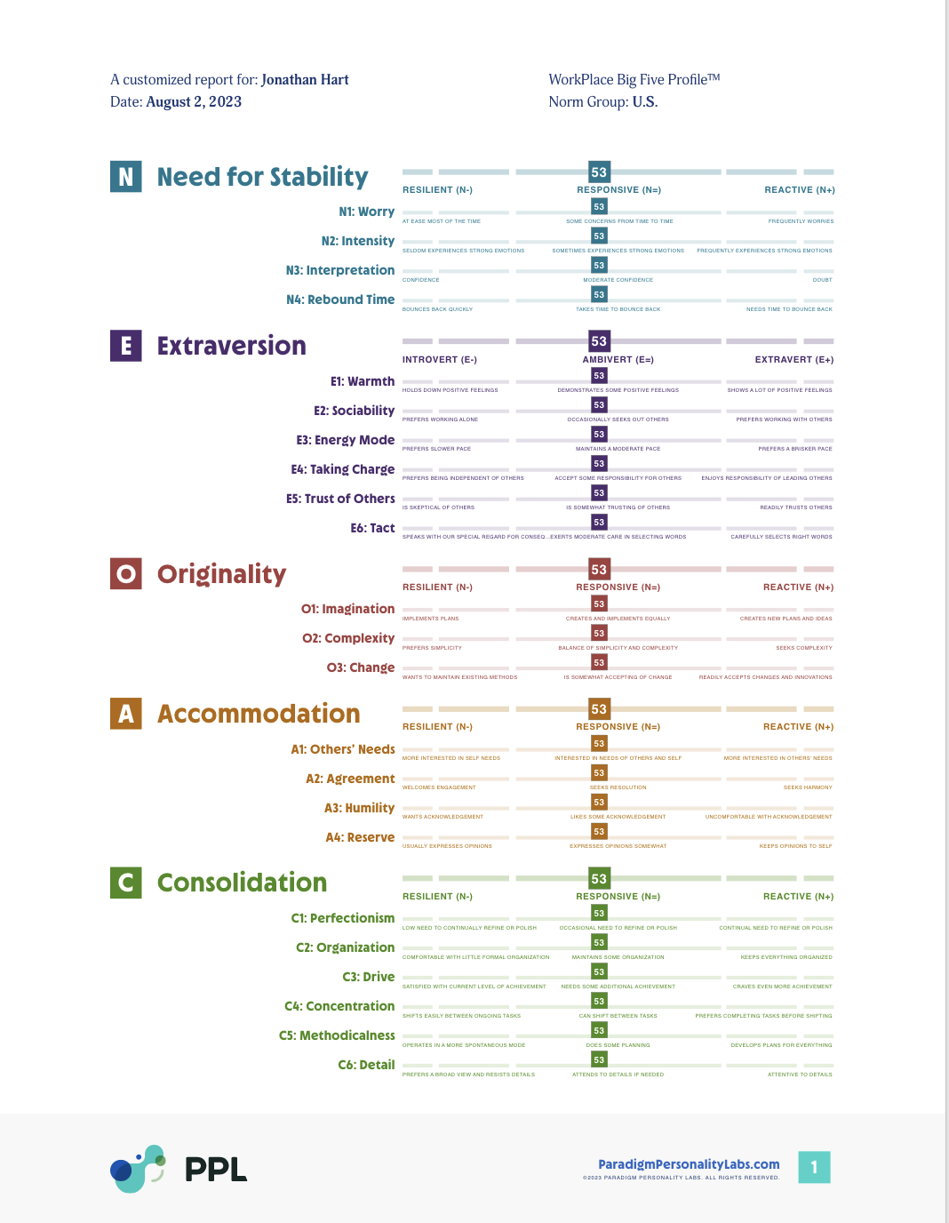
WorkPlace Big Five Profile™ Trait Report
Page 17
Composite of 5 supertraits
& 23 subtraits
PARADIGM PERSONALITY LABS |
May 24
© PARADIGM PERSONALITY LABS. ALL RIGHTS RESERVED.
Notes:
Page 17 in your WorkPlace Big Five ProfileTM Trait Report is a composite of all the scores we just reviewed.
At a glance you can see where your scores fall in the middle range, (between 45 and 55), where they fall in the high range (56 or higher), and where they fall in the low range (44 or lower).
Let’s check in again here:
What is your initial reaction to your scores?
Are there any surprises?
What questions come up for you as you see your score?
Remind the participants: this is your personality “THUMBPRINT”- singularly yours; it does not label or stereotype you because you are too unique to be boxed in!

Slide 92



Leading with your best self
WorkPlace Big Five Profile™
Trait Energy
PARADIGM PERSONALITY LABS
May 24
Notes:
We’ve discussed traits from the perspective of energize and drain.
Your personality awareness is a powerful tool to help you bring your best and feel yourself.

Slide 93
“The core problem with working longer hours is that time is a finite resource. Energy is a different story.”
TONY SCHWARTZ AND CATHERINE MCCARTHY,
OCTOBER 2007, MANAGE YOUR ENERGY, NOT YOUR TIME, HARVARD BUSINESS REVIEW
PARADIGM PERSONALITY LABS |
May 24
© PARADIGM PERSONALITY LABS. ALL RIGHTS RESERVED.
Notes:
This is the premise of trait energy. Perseverance and grit can keep you moving, but they aren’t the sole determinants of optimal performance. Creating the conditions for well-being at work with trait energy will provide you with the energetic lift to recharge and reach your peak performance.

Slide 94





PARADIGM PERSONALITY LABS |
May 24
© PARADIGM PERSONALITY LABS. ALL RIGHTS RESERVED.
©2023 PARADIGM PERSONALITY LABS. ALL RIGHTS RESERVED.
94
PAGE
Notes:
You charge your phone when it’s low right away, do you take the same care with your own energy?

Slide 95

You are a renewable energy source
May 24
PARADIGM PERSONALITY LABS |
© PARADIGM PERSONALITY LABS. ALL RIGHTS RESERVED.
Notes:
It is when you manage your energy, not when you pound through working more hours, that you perform at higher levels and feel your best.
It’s really about working smarter.

Slide 96

I know I’m feeling DRAINED when…
May 24
PARADIGM PERSONALITY LABS |
© PARADIGM PERSONALITY LABS. ALL RIGHTS RESERVED.
Notes:
Describe Drain.
What are the thoughts, feelings, body sensations?
Share.

Slide 97

I know I’m feeling ENERGIZED when…
May 24
PARADIGM PERSONALITY LABS |
© PARADIGM PERSONALITY LABS. ALL RIGHTS RESERVED.
Notes:
Think about which workplace tasks and roles energize you most?
What are the thoughts, feelings, body sensations that you notice when you think about these energized tasks or are engaged in them?
Share.

Slide 98

Trait Energy:
The Natural Vitality
that a person experiences when spending time engaged in work that matches their personality.
May 24
PARADIGM PERSONALITY LABS |
© PARADIGM PERSONALITY LABS. ALL RIGHTS RESERVED.

Slide 99
Trait Energy
You’ll feel more engaged with your work and enjoy being at work. Trait Energy is a tool for recognizing, managing, and maximizing your energy so that you’re at your most creative, productive, and fulfilled during your workday.
Why it Matters
The Workplace Big Five Profile™ provides the framework to better understand how your work tasks, behaviors, and roles are either energizing or draining – according to your unique personality.
Leveraging
Personality
PARADIGM PERSONALITY LABS |
May 24
© PARADIGM PERSONALITY LABS. ALL RIGHTS RESERVED.
Notes:
The Workplace Big Five Profile™ provides the framework for you to better understand how your various work tasks, behaviors, and roles are either energizing or draining – according to your unique personality.

Slide 100
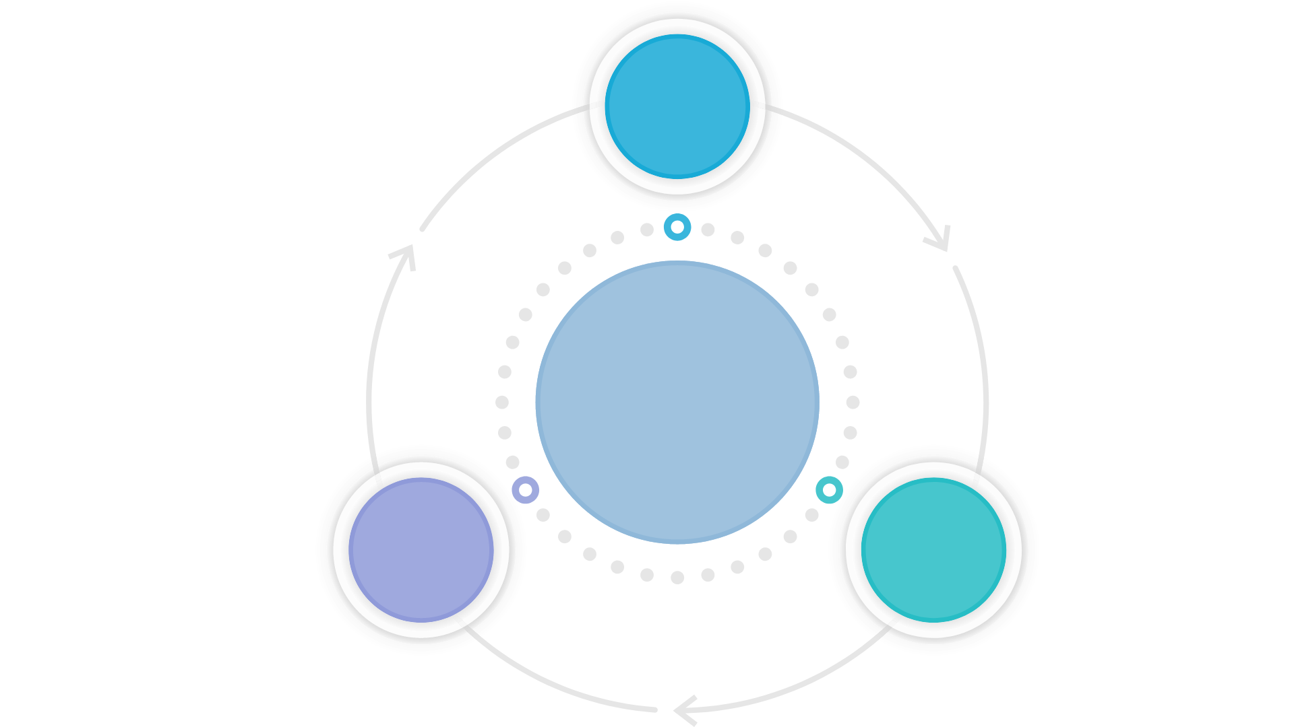



Trait Energy in the
Workplace
The ideal work role is one that closely matches our natural preferences.
We create the conditions for individuals and organizations to thrive.
When doing things that come naturally to us, we tend to excel without effort; finding solutions faster and better than others.
A Brighter Way to Solve Well-being, Effectiveness, & Engagement
PARADIGM PERSONALITY LABS |
May 24
© PARADIGM PERSONALITY LABS. ALL RIGHTS RESERVED.
Notes:
Here’s the why of Trait energy
The ideal work role for us is one that matches our natural preferences.
When we do what is natural to us, we not only significantly increase our chances of success, we thrive.
This is because we can sustain the energy required to succeed every day and over the long-term.
We tend to excel without effort; find solutions faster and better; remain internally motivated; and in the long term, stay mentally and emotionally content.
When we manage our trait energy, we take a big step towards reaching and staying in this healthy and productive state—and are more creative. Under stress and negative emotions, our brain has a narrower field of vision.

Slide 101


100% job-person fit doesn’t exist
May 24
PARADIGM PERSONALITY LABS |
© PARADIGM PERSONALITY LABS. ALL RIGHTS RESERVED.
Notes:
News alert: None of us is a 100% perfect match for our roles. Let’s normalize this so that you can clearly identify the things that naturally energize you and drain you. This is the first step towards managing your energy effectively at work.
The reality is this: certain aspects of the work role often fit and others don’t. Keep in mind, it can also change based on the situation. Sometimes the same trait that helps in one situation hinders you in another. For example, someone who scores high in C4: Concentration would find this helpful when working on deadline-intense projects. However, this same trait could hinder that person when priorities compete and require the focus to shift repeatedly.
Understanding personality fit is not a measure of performance, but rather a measure of the impact of the trait energy on your role. This activity helps you determine which traits help you and which hinder you at work.

Slide 102
Trait Energy in Action
Low Trait Energy
High Trait Energy
Working against your natural strengths
Increased drain and effort
Reduced focus and effectiveness
Increased procrastination
Fewer positive emotional states
Burnout and compromised emotional and physical states when sustained and pervasive
Express and use your unique behavioral strengths
Maintain high levels of sustained engagement
High performance, well-being, and purpose
Increased creativity, insights, and positive emotional states
More likely to achieve flow states
PARADIGM PERSONALITY LABS |
May 24
© PARADIGM PERSONALITY LABS. ALL RIGHTS RESERVED.
Notes:
On the left is the impact of low trait energy – working against your default traits,
And on the right, working with your personality
Read this. What observations do you have?

Slide 103

Leaning into your default nature
May 24
PARADIGM PERSONALITY LABS |
© PARADIGM PERSONALITY LABS. ALL RIGHTS RESERVED.
Notes:
…is the source of increased engagement with your work – the oomph for creativity, sustained effort, and well-being. Your default nature is reflected in your personality. So by aligning your work with your WorkPlace Big Five Profile trait scores and Trait Energy principles, you’ll rely on the behaviors that are most natural for you, and actively manage those that are less natural for you.

Slide 104



Intentional vs. Ingrained Behaviors:
The Trait Energy Connection
Biogenic
Biogenic
Sociogenic
Idiogenic
Acting from a genetic basis
Comes from socialization
Context motivates you
to stretch and be the behavior – the “why”
PARADIGM PERSONALITY LABS |
May 24
© PARADIGM PERSONALITY LABS. ALL RIGHTS RESERVED.
Notes:
Another newsflash: as we learned with trait variance, it is natural for us to make slight shifts in our behaviors. [This is an advancement in personality research that comes from Dr. Brian Little.]
It’s a helpful framework to understanding how we may adjust our behaviors - and how this adjustment impacts our trait energy.
Brian Little says that the behaviors you display on any particular day could be biogenic, sociogenic, and/or idiogenic
See video for quick reference - https://knowledge.wharton.upenn.edu/article/the-science-of-personality-understanding-yourself-and-those-around-you/
You can also read more in his book – Me, Myself, Us (By Brian Little)
Biogenic:
Acting from a genetic basis offers the most benefits.
it is natural
leads to well-being
can be sustained for a long period of time
Sociogenic:
Acting because of socialization may also seem normal because of conditioning and not knowing otherwise. However, prolonged socialized behavior contrary to who you are has been proven to create physiological distress.
Idiogenic:
Also known as personal projects (being engaged in projects that personally matter to us)
Being motivated by the context and personal projects can be an enjoyable experience. However, if this is unlike your natural self, you are not likely to be able to sustain high performance without it affecting your well-being.

Slide 105
Ingrained vs. Intentional Behaviors
Example:
At work you may show high Accommodation to your manager, because:
You are accommodative by nature
Organizational culture mandates deference to higher-ups
It serves your best interests
PARADIGM PERSONALITY LABS |
May 24
© PARADIGM PERSONALITY LABS. ALL RIGHTS RESERVED.
Notes:
Here’s an example of how ingrained versus intentional behaviors can play out.
The reason we could show up as high in Accommodation – deferential and seeking to be agreeable – could be:
Ingrained – that it is simply your nature; e.g. you score highly on the overall supertrait Accommodation.
Intentional – conforming to social or company/team cultural norms, of exhibiting accommodating behaviors. Sometimes we aren’t aware of this. We’ve been playing the part so long that we don’t recognize it.
Sometimes, we adopt behaviors to help us realize a specific goal.

Slide 106




Trait Energy Case Study:
Kayla
Dreads reviewing detailed weekly sales reports
Loves brainstorming
Direct report, Ben, loves facts and figures
Kayla now spends this time on free-form
90-minute strategy sessions
Ben provides her executive summaries and appreciates the work and the daily interaction with his manager, Kayla
PARADIGM PERSONALITY LABS |
May 24
© PARADIGM PERSONALITY LABS. ALL RIGHTS RESERVED.
Notes:
How does this play out?
Here’s a micro case study to see what this looks like in action.

Slide 107

Essentialism: only once you give yourself permission to stop trying to do it all, to stop saying yes to everyone, can you make your highest contribution towards the things that really matter.
GREG MCKOWN
May 24
PARADIGM PERSONALITY LABS |
© PARADIGM PERSONALITY LABS. ALL RIGHTS RESERVED.
Notes:
This is a helpful wisdom nugget, especially if we find ourselves saying yes too often.
Finding ways to create well-being WHILE working is not a luxury, it’s a necessity.

Slide 108
Be Your Best, Feel Your Best
Identify Your Trait Energy
Self reflection: 5 minutes
Small group walk and talk: 7 minutes
Identify one task or role for which you have draining trait energy?
What is the related subtrait (or subtraits)?
What is the impact on you personally in terms of your energy, performance, and mood?
PARADIGM PERSONALITY LABS |
May 24
© PARADIGM PERSONALITY LABS. ALL RIGHTS RESERVED.
Notes:
Breakout Exercise: First, time 5 minutes for reflections, then place in small groups for seven minutes.

Slide 109
Trait Energy Tactics
Helping Your People Put Trait Energy Into Practice
May 24
PARADIGM PERSONALITY LABS |
© PARADIGM PERSONALITY LABS. ALL RIGHTS RESERVED.
Notes:
Let’s bring the concept into action.

Slide 110

Trait Energy Amplifiers
AMPLIFIER
HOW
Create “work activity chunks”
Batch activities
Create extended periods of uninterrupted focus
Breakup draining, necessary tasks
Bookend energy-draining tasks
Schedule energizing tasks first
Energy Microburst Tactics
Proactively manage your energy calendar
Align tasks to leverage your natural trait energy
Offset the drain from activities that present challenges
PARADIGM PERSONALITY LABS |
May 24
© PARADIGM PERSONALITY LABS. ALL RIGHTS RESERVED.
Notes:
These are strategies that can lift your workday energy.
Given that we have some tasks that drain us due to our inherent trait infrastructure, how can we manage ourselves and our workday for optimal well-being and performance?
Work tasks:
By understanding which tasks energize and drain us – like we thought through in the exercise earlier – we can manage our day by borrowing a term from the financial industry – ‘portfolio management’.
Evaluate your basket of activities for any given day, week, month, and allocate your resources.
Here are some suggestions:
CREATE WORK CHUNKS -Schedule your draining activities in manageable chunks for you. This can very from person to person and task to task, based on how draining the task is for you.
BE PROACTIVE WITH YOUR ENERGY CALENDAR -Schedule activities that are energizing for you before and after draining activities.
USE THE BOOKEND APPROACH -In this way you ‘bookend’ the draining activity and use the energizing activities as energy boosters to help you accomplish the draining activities and those for which you have slightly less natural energy.
LEVERAGE YOUR CIRCADIAN RHYTHM -Schedule draining tasks during the time of day when you have more energy. For example, if you are an Extravert, research says that you are likely to be slower to wake. If this is true for you, schedule an energizing activity to start your morning and then move on to the draining task that needs your attention.
TAKE INVENTORY OF YOUR PERSONAL PROJECTS Take time to identify and take stock of your own personal projects. Evaluate their overall impact on your energy and carefully decide, based on importance and your values, whether you need to prune or otherwise redesign your personal projects to maximize the balance between your energy, your well-being and your work goals.
ADAPT TO THE DRAIN: REFRAME & OFFSET - Evaluate those activities you find draining and decide if there are any work arounds, skill enhancement, or perhaps even mindset adjustment, e.g. reframing the task, that can help you ensure the draining task is done, done well, and with less drain on you. Recognize that there are times when grit, perseverance, and positive mental attitude are the best medicine to dig in and do certain tasks to the best of your ability. It would be unrealistic that we could design a career, with roles and tasks that set us on fire every moment of every day.

Slide 111
Trait Energy Management Performance Strategies
Increase Energy
Decrease Drain
Redesign roles or tasks to better align with one’s Trait Energy.
Schedule a dedicated 1:1 meeting with your direct report/leader to review your personality profile and evaluate current role responsibilities with respect to trait energy and drain. Identify opportunities to further leverage strengths or reduce drain by redefining or shifting specific tasks.
Ask your colleagues for suggestions on new tools or more efficient processes for handling draining tasks. Internal message boards and LinkedIn forums, particularly those focused on a specific aligned domain. People are often surprised how willing others are to share their ideas and suggestions.
Explore new processes & technologies to streamline time spend on draining tasks.
Schedule a brief, dedicated 1:1 session to talk openly about strengths, challenges, and opportunities for collaborating differently for mutual gain. Often task sharing with someone else on the team can share the draining task or take over a particularly draining aspect of it. This is a way for teammates to leverage their unique Trait Energy.
Ask colleagues for suggestions/ tips on using specific tools more efficiently and effectively. Look for on-line courses and free videos. We often don’t know what we don’t know so taking a course focused on a tool that you already think you know well may reveal a few simple tips and techniques that have a big impact on your effectiveness.
Identify skill gaps related to the energy drain that would increase confidence, performance, and subsequent well-being.
Divide and conquer tasks with teammates.
PARADIGM PERSONALITY LABS |
May 24
© PARADIGM PERSONALITY LABS. ALL RIGHTS RESERVED.
Notes:
Ask participants to read this slide.
Ask, “What is one key insight for you?”
Share an example.

Slide 112
Energy Microburst Tactics:
When you feel the drain but need to push through
ACTION
BENEFIT
Start your first moments of
the day outside.
Pause and reset.
Schedule internal meetings for
25 or 50 minutes instead of the
standard 30 or 60 minutes.
Change your scenery!
Honor your accomplishments.
Offer random kindness.
This will help regulate cortisol and melatonin levels in your body. You’ll feel more alert, calm, and ready to start your day.
An intentional break of mindful breathing, a brief meditation, stretching, or 10 minutes of walking, or other favorite exercise can all provide renewed energy to our day and help recenter our work. Also, don’t forget the power of a mini-nap!
This will give you and your colleagues a brief respite to recharge before the next task.
Sometimes simply taking your laptop to another area can help refuel or expand your perspective.
Anytime you feel drain, make a list of the things that you’ve accomplished and done well within the last week or month.
Doing something to brighten someone else’s day will likely provide the same impact for you.
PARADIGM PERSONALITY LABS |
May 24
© PARADIGM PERSONALITY LABS. ALL RIGHTS RESERVED.
Notes:
What are microbursts? These are things you can do to get a burst of energy to sustain you during times of draining tasks.
As we go through them, make a note of the ones that appeal to you.
The following two slides are starter lists.

Slide 113
Energy Microburst Tactics
ACTION
BENEFIT
Take a gratitude moment.
Research shows that writing a short list of daily gratitude serves as a sustained pick-me-up.
Play some music.
Your favorite music has the power to quickly bring an energy lift.
Switch to “old-fashioned” pen and paper to take notes, sketch a
work outline, or even doodling can provide a needed change.
Research shows pen-and-paper improves retention and deepens processing.
If you are feeling frustration with a task you’re working on, coming out of a tough discussion, or otherwise dealing with draining event, don’t just plow ahead. Instead, take some time to acknowledge your feelings. Often, this is all you need to help refocus and positively reset.
Stop to acknowledge.
Get creative!
Whether it’s writing or painting, designing, or building, each of us has a unique path to sparking joy and energy through creating.
PARADIGM PERSONALITY LABS |
May 24
© PARADIGM PERSONALITY LABS. ALL RIGHTS RESERVED.
Notes:
Review these in your own language.
[Can also provide this as part of a handout.]

Slide 114




Be Your Best, Feel Your Best
Energy Microburst Tactics
Why you have the time for Energy Microbursts
May 24
PARADIGM PERSONALITY LABS |
© PARADIGM PERSONALITY LABS. ALL RIGHTS RESERVED.
Notes:
The term “attention residue” comes from Sophie Leroy & Cal Newport (he wrote Deep Work).
The concept is this:
When you switch from one activity or task, research shows your attention doesn't immediately follow- your still stuck in the first task and this contribute to poor performance on the next task.
Research shows that multitasking can add up to a 40% loss of productivity in a day. This decrease in productivity is called task switch cost.
Many of us have convinced ourselves that multitasking leads to greater productivity. It’s quite the opposite.
So before you are tempted to immediately move on to the next item on your to-do list,
why not instead transition with a microburst? You’ll help your brain and your productivity with a more intentional break between the two activities. The research is compelling.

Slide 115
Be Your Best, Feel Your Best
Energy Microburst Tactics
Share
What are your favorite personal microbursts that you use to recharge?
May 24
PARADIGM PERSONALITY LABS |
© PARADIGM PERSONALITY LABS. ALL RIGHTS RESERVED.
Notes:
Discuss the answers.

Slide 116

Be Your Best, Feel Your Best
Trait Energy
3 minutes reflect individually
3 minutes walk and talk sharing (2 - 3 ppl)
One thing I need to let go of is__________?
I will give myself more permission to__________?
As a result of this, what will I be able to give back
to my team/friends/family (the positive impact)?
May 24
PARADIGM PERSONALITY LABS |
© PARADIGM PERSONALITY LABS. ALL RIGHTS RESERVED.
Notes:
Ask each question one at a time and read the answers in chat for the question, or if live ask for answers, then proceed to the next question.
Or what’s the thing you’re doing that’s NOT working for you?
What do you need to do more of to feel well?
As a result of doing both of these, what do you offer your world?

