Slide 1
Trait Blends: Facilitator Guide
Purpose:
  This PowerPoint deck is intended to be used to introduce participants to the concept of Trait Blends. The intent is to help participants understand the dynamics of the way their traits and supertraits interact—leading to a deeper understanding of their results.
Slide Notes:
  Most of the slides contain facilitator notes. These are not scripts for you to follow word for word--rather they identify key points for each slide and offer suggestions for presentation.
Positioning:
  This presentation should be used after the participants have received and reviewed their own Trait Report results and have a basic understanding of their results.
Time Required:
  The full presentation can be delivered in a one-hour module including the small group activities. If necessary, the module can be shortened to approximately 30 minutes by:
  Eliminating the small group activities and discussions
  Ending the module after slide 18 and excluding the discussion of the Competency Report.

Slide 2
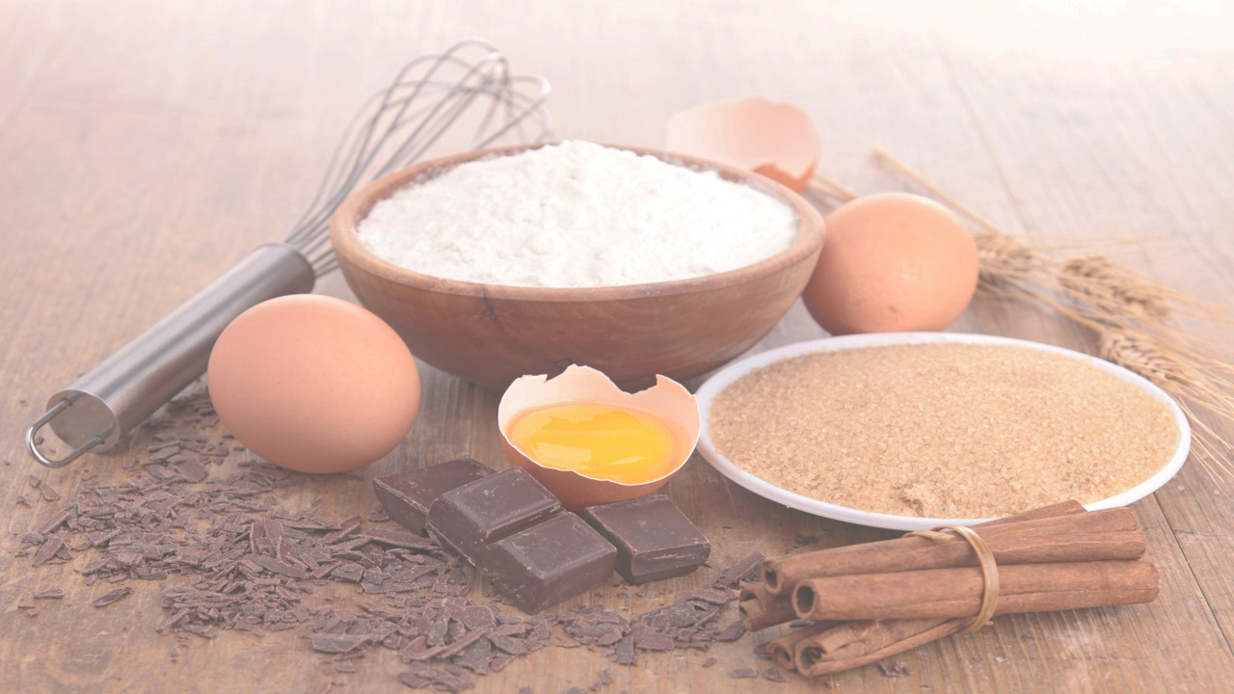

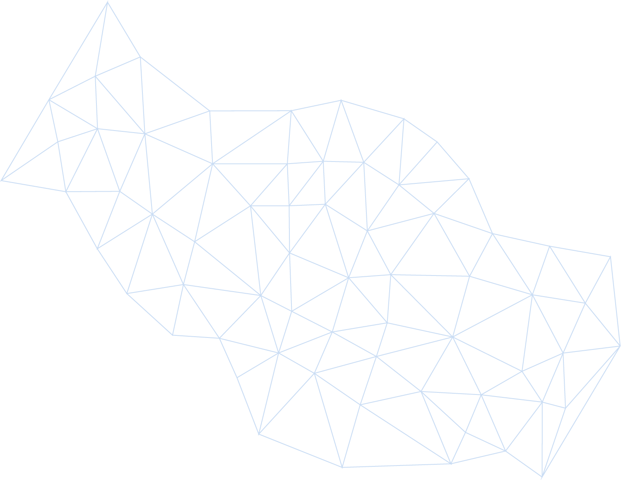
Trait Blends
© PARADIGM PERSONALITY LABS. ALL RIGHTS RESERVED.
Notes:
In this session we are going to focus on trait blends.
While trait and subtrait scores tell us a lot about our personality, the gold nuggets are in the way that traits and subtraits blend together to magnify or moderate each other.
This is a way to take your understanding of your Trait Report to a much higher level

Slide 3
Objectives
Define and describe Trait Blends
Understand the importance of Trait Blends
Examine some Trait Blend examples
Respond to any questions you have
© PARADIGM PERSONALITY LABS. ALL RIGHTS RESERVED.
Notes:
The way we will do this is by:
Getting clear on what we mean when we talk about trait blends.
Focusing on the way that trait blends together, and most importantly, the way they impact our behavior.
Doing some work in small groups identifying some common trait blends
Responding at the end to any questions you have and discussing next steps.

Slide 4
WorkPlace Big Five Profile™
Trait Report
Levels of Mastery
Basic:
Moderate:
Advanced:
Supertraits
Subtraits
Trait blends
© PARADIGM PERSONALITY LABS. ALL RIGHTS RESERVED.
Notes:
This slide just shows the levels of mastery you can follow to get the most from your report
Understanding the five supertraits is an important first step (including where your scores come from and how they are presented against a normative base on the Trait continuum).
Digging into the subtraits gives us a much better and more detailed insight than Trait scores alone.
Where we want to get to today, is taking it to another level by understanding the way that traits and subtraits blend together to magnify or moderate each other.

Slide 5
What are Blends?
What are blends?
A blend is the combination of two or more supertraits or subtraits that result in a pattern of behavior
© PARADIGM PERSONALITY LABS. ALL RIGHTS RESERVED.
Notes:
This is a basic definition of blends
It is the way that those traits work together that is important.
Each trait, independent of the other, might result in different behaviors.
When combined together, they can lead to patterns of behavior.
Just as a reminder, it is the way our personality traits manifest in behavior that others see. It is what they use to make decisions about us.

Slide 6
Trait Blends
Our traits and subtraits do not exist in isolation. They often combine to magnify or moderate each other.
“Why is it that when you mix flour and water you get paste…
…but when you add eggs, sugar, and a little vanilla, you get a cake?” –Rita Rudner
© PARADIGM PERSONALITY LABS. ALL RIGHTS RESERVED.
Notes:
Our personalities are like recipes. None of the ingredients exist in isolation.
They are all blended together to create our unique personalities.
Eggs don’t become a cake until they are combined with other ingredients
By the same token, High Perfectionism alone doesn’t tell the whole story. What if it is combined with High Warmth?

Slide 7

Trait Blend Examples
  Determined is associated with 2 subtraits:
    High Energy Mode (E3+)
    High Drive (C3+)
  Antagonistic is associated with 2 subtraits:
    High Intensity (N2+)
    Low Agreement (A2-)
  Friendly is associated with 2 subtraits:
    High Warmth (E1+)
    High Sociability (E2+)
© PARADIGM PERSONALITY LABS. ALL RIGHTS RESERVED.
Notes:
At this point, it is useful to look at some examples.
Research studies* show that trait (and especially subtrait) blends are empirically linked to additional behaviors beyond the individual traits. For example:
People with high Energy and high Drive are often described as Determined.
People with high Intensity and low Agreement are often described as Antagonistic.
People with high Warmth and high Sociability are often described as Friendly.
Determined, Antagonistic, and Friendly are not stand-alone subtraits, they are adjectives people use to describe the way they see those subtraits play out behaviorally in people.
This is why it is so important for us to understand the impact of trait blends
*from The Owner’s Manual for Personality at Work, 2nd ed. The research is also cited in the Trait Dictionary, a good resource for practitioners, located here in the Practitioner Toolbox: https://mydashboard.paradigmpersonality.com/consultant/toolbox

Slide 8
Why Are Blends Important?
Understanding blends gives us deeper insight into the range of behaviors we demonstrate and also observe in others.
© PARADIGM PERSONALITY LABS. ALL RIGHTS RESERVED.
Notes:
Blends take us deeper into the Big Five personality model. It allows us to understand behavior in a much deeper fashion than by considering traits and subtraits in isolation.

Slide 9

Why Are Blends Important?
Subtrait blends make up the recipe of our personality
Our personality drives our behavior
Our behaviors are what we show the world—they are what people use to make decisions about us.
Behavior
Personality
© PARADIGM PERSONALITY LABS. ALL RIGHTS RESERVED.
Notes:
Traits and trait blends make up the recipe of our personality
Our personalities inform our behaviors
Our behaviors are what we show the world—they are what people use to make decisions about us.

Slide 10

Which traits relate to Approachable?
Approachable
E1+ High Warmth
E2+ High Sociability
A1+ High Others’ Needs
E5+ High Trust of Others
© PARADIGM PERSONALITY LABS. ALL RIGHTS RESERVED.
Notes:
Think of someone whom you consider to be approachable. What are some of the subtrait scores that you think apply to this person? (Optional, tell them that there are three—can help them focus)
An individual that is both warm (E1+) and sociable (E2+) and low in agreement (A1-) will feel much more approachable and less competitive than an individual that is lower in warmth and sociability.
Since this is the first example you are working on, take some time here to answer questions and provide more detail to help people see the connection.

Slide 11

Which traits relate to Confident?
Confident
N1-- Low Worry
N3-- Low Interpretation
A4-- Low Reserve
C1+ High Perfectionism
© PARADIGM PERSONALITY LABS. ALL RIGHTS RESERVED.
Notes:
Let’s do another one.
When you think of someone whom you consider to be confident, what subtraits would apply?
An individual that is both calm and worry-free (N1-), feels confident that they can succeed and overcome obstacles (N3-), expresses their opinion readily and comfortably in front of groups (A4-), and has high levels of perfectionism (C1+), will show up as confident.
N1- - Low score on worry
N3- - low score on interpretation – “things will work out in most situations” – a get back on the horse (back on the bike… etc.)
A4 – low score on reserve – comfortable in front of a room and take any opportunity to get up and talk whether prepared or not
C1+ “My work is a direct reflection of me. I take the extra time to get it 100% right. When I do make a mistake, I cringe. I expect the same from others.”

Slide 12
t are blend?
Trait Blend Activity: Try on your own
In your breakout group discuss which traits and subtraits might be related to Spontaneous.
© PARADIGM PERSONALITY LABS. ALL RIGHTS RESERVED.
Notes:
Set up group breakout activity
In groups of 3 or 4
The first characteristic to consider is Spontaneous.
Send the groups a sample report (page 17).
Give them 5 minutes to discuss
Bring them back in and debrief
Do the last two in the full group
3 blends we decided on were resourceful, confrontational

Slide 13

N2+ High Intensity
N3- Low Interpretation
E6+ High Tact
O1+ High Others’ Needs
O3+ High Change
A2- Low Agreement
C4- Low Concentration
C5- Low Methodicalness
Spontaneous
© PARADIGM PERSONALITY LABS. ALL RIGHTS RESERVED.
Notes:
Small groups report out on their discussion
Spontaneous
The more of these subtraits you have, the more likely that you and others would describe you as spontaneous.
High Intensity, Low Energy Mode (N2+,3-)
High Tact E6+
High others needs and Change (O1, 3+)
Low Agreement (A2-)
Low Concentration and low Methodicalness (C4,5-)

Slide 14
t are blend?
Trait Blend Activity: Try on your own
In your breakout group discuss which traits and subtraits might be related to Confrontational.
© PARADIGM PERSONALITY LABS. ALL RIGHTS RESERVED.
Notes:
Back into small group with second blend: Confrontational
Give them 5 minutes to discuss
Bring them back in and debrief

Slide 15
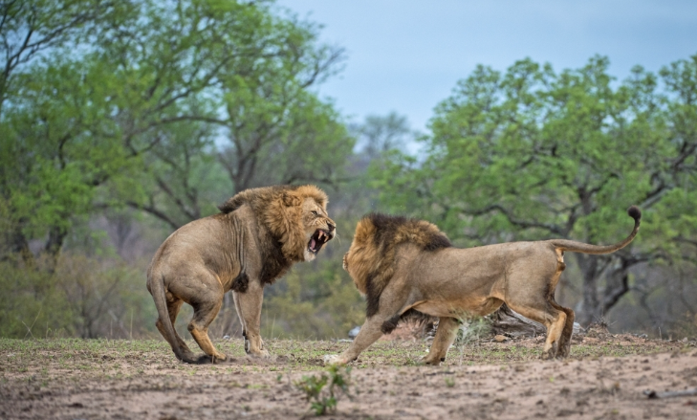
N4+ High Rebound Time
O3- Low Change
A1- Low Others’ Needs
A2- Low Agreement
A4- Low Reserve
Confrontational
© PARADIGM PERSONALITY LABS. ALL RIGHTS RESERVED.
Notes:
People who have all or many of these subtraits are likely to be described by themselves or others as Confrontational
N4+ High Rebound Time
O3- Low Change
A1- Low Others’ Needs
A2- Low Agreement
A4- Low Reserve
Let’s do one more

Slide 16

Self-Reliant
N4- Low Rebound Time
E4+ High Taking Charge
O1+ High Imagination
O2+ High Complexity
A2- Low Agreement
C1- Low Perfectionism
© PARADIGM PERSONALITY LABS. ALL RIGHTS RESERVED.
Notes:
Small groups report out on their discussion
Self-Reliant
Low rebound time (N4-)
High preference for taking charge (E4+)
High imagination and complexity (O1, 2+)
Low agreement – welcomes engagement (A2-)
Low perfectionism (C1-)

Slide 17

N1- Low Worry
N3- Low Interpretation
N4- Low Rebound Time
E1+ High Warmth
E5+ High Trust of Others
O2+ High Complexity
C1+ High Perfectionism
C3+ High Drive
Resourceful
© PARADIGM PERSONALITY LABS. ALL RIGHTS RESERVED.
Notes:
Ask in large group for individuals to share subtraits related to resourceful
Resourceful
Low worry, intensity and interpretation (N 1,2,3-)
High warmth and trust of others (E1,5+)
High Complexity – seeks complexity (O2+)
High Perfectionism and high drive (C1,3+)

Slide 18

N2- Low Intensity
A3+ High Humility
A4+ High Reserve
Team Player
© PARADIGM PERSONALITY LABS. ALL RIGHTS RESERVED.
Notes:
Hint: there are three subtraits that load onto Team Player
Low worry and intensity (N 1,2 –)
High Energy Mode (E3+)
Very high imagination, high complexity and change (O1++ 2,3+)
High Humility (A3+)
High perfectionism, drive and methodicalness (C 1, 3, 5+)

Slide 19
Trait Blends
Blends are accessible in two places:
Spread across the Trait Report
As a component of the Competency Report
© PARADIGM PERSONALITY LABS. ALL RIGHTS RESERVED.
Notes:
There are two places where blends are available:
1. In the trait report (as we just learned)
2. As the central component of the Competency Report
The difference is, in the trait report, we consider blends as a way to understand an individual’s behavior.
In the Competency Report, the blends are already sorted and organized according to how they match with specific job competencies.
Remember that this is an indication of personal energy, not effectiveness

Slide 20
Effective Communications
© PARADIGM PERSONALITY LABS. ALL RIGHTS RESERVED.
Notes:
Bring the concept home by explaining that blends and competencies are very similar in that they both have supporting subtrait infrastructure.

Slide 21
Strategic
© PARADIGM PERSONALITY LABS. ALL RIGHTS RESERVED.

Slide 22
Effective Communications--Identifiers
Cares about the precision and subtlety of clear written and spoken communication.
Listens objectively and knows how to facilitate mutual understanding across different contexts.
Advocates for high-quality communication in internal and client relationships.
© PARADIGM PERSONALITY LABS. ALL RIGHTS RESERVED.
© PARADIGM PERSONALITY LABS. ALL RIGHTS RESERVED.
Notes:
In the Competency Report, each of the Competencies lists three identifiers that give us an idea of what that competency gets at. For Effective Communication, here are the three

Slide 23
Effective Communications
Which subtraits do you think relate to effective communication?
© PARADIGM PERSONALITY LABS. ALL RIGHTS RESERVED.
Notes:
With that in mind, what would you guess are the subtraits that load onto Effective Communication?

Slide 24
Effective Communications
N2: Intensity
N3: Interpretation
E2: Sociability
A4: Reserve
C1: Perfectionism
© PARADIGM PERSONALITY LABS. ALL RIGHTS RESERVED.
Notes:
Subtraits that are high energy for Effective Communication:
N2: INTENSITY Low and moderate levels of Intensity provide the calm needed to maintain emotional control and avoid emotionally intense, counterproductive exchanges.
N3: INTERPRETATION Moderate levels of Interpretation provide the positive tone and optimism to handle challenging communications without ignoring serious concerns, potential derailments or other negative outcomes.
E2: SOCIABILITY Moderate or high Sociability levels provide energy to engage with clients and stakeholders, understand their perspectives, and craft the contexts and messages supporting mutual understanding and shared goals.
A4: RESERVE Moderate levels of Reserve support strategic sharing of thoughts and opinions without providing too much information or interfering with others' expression.
C1: PERFECTIONISM Those with high levels of Perfectionism recognize that even subtle changes in wording (spoken or written) can dramatically impact relationships by creating or destroying critical common ground.

Slide 25
Vision--Identifiers
Enjoys creating the compelling strategic vision that spurs sustained organizational action.
Prefers focus on longer-term strategic horizons rather than day-to-day operational details.
Aligns vision, capabilities, and anticipated market needs to drive the business forward.
© PARADIGM PERSONALITY LABS. ALL RIGHTS RESERVED.
Notes:
Let’s consider one more. These are the three descriptors that help us understand the Competency called Vision.

Slide 26
Vision
What subtraits do you think
relate to vision?
© PARADIGM PERSONALITY LABS. ALL RIGHTS RESERVED.
Notes:
What subtraits would you think load onto Vision?

Slide 27
Vision
N3: Interpretation
E3: Energy Mode
O1: Imagination
O2: Complexity
C6: Detail
© PARADIGM PERSONALITY LABS. ALL RIGHTS RESERVED.
Notes:
Subtraits that are high energy for Vision:
N3: INTERPRETATION Low to midrange Interpretation scores generally allow people to scan for a broader array of ideas
E3: ENERGY MODE High Energy Mode scores support a focus on pace and action for the vision and strategic process.
O1: IMAGINATION High Imagination scores fuel ideation for strategic and visionary thinking
O2: COMPLEXITY People with high scores on Complexity have natural energy to foresee, consider and solve downstream business implications of potential strategies.
C6: DETAIL Low to midrange scores on Detail enable individuals to scan for details to consider in strategic action. This grounds and fortifies visionary processes with actionable components

Slide 28

© PARADIGM PERSONALITY LABS. ALL RIGHTS RESERVED.
Notes:
We spent a lot of time considering the way our traits and subtraits work together.
Doing so is essential to get the most out of your WorkPlace reports.
Questions?
Next steps
So what for selection? Development? Teams?

Slide 29

Thank you for
your participation!
© PARADIGM PERSONALITY LABS. ALL RIGHTS RESERVED.

Slide 30
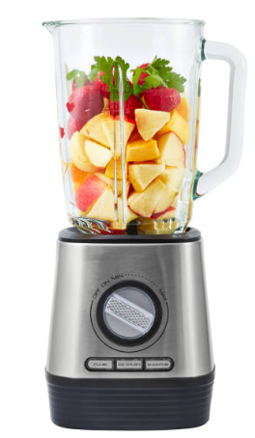
Trait Blends
© PARADIGM PERSONALITY LABS. ALL RIGHTS RESERVED.

Slide 31

The Paradigm People Development (PPD) Model
What are blends?
What are the behaviors required for optimal performance in a given competency?
What is the natural behavioral energy – based on your subtraits – that you bring to perform the competency?
What are the options – ways to leverage strengths and create workarounds for weaknesses – for achieving and sustaining optimal performance?
© PARADIGM PERSONALITY LABS. ALL RIGHTS RESERVED.
Notes:
Consider HR department practices in the past (and unfortunately one that continues in some places now) that consider any challenge an individual faces as a training need. Person A prefers working alone and does not seem interested in becoming a manager? Send them to leadership training. Person B needs time to bounce back from setbacks? Make them read a book about resilience. The Paradigm People Development Model is designed to look beyond training as the only answer for developing people.
Understanding the way your traits and subtraits blend helps you assess your behavioral competency strengths and challenges.
The goal is to help you create and maintain a state of enhanced concentration and energy.
By recognizing and acknowledging your behaviors and the natural energy around them, you can create habits that reinforce your strengths and find ways to reenergize you after draining tasks.
The PPD Model is designed to help you optimize your energy by identifying the subtraits related to each competency. The Competency Report quickly identifies traits that reinforce your behavioral tendencies and provide insight to traits where you need to seek additional support.

Slide 32
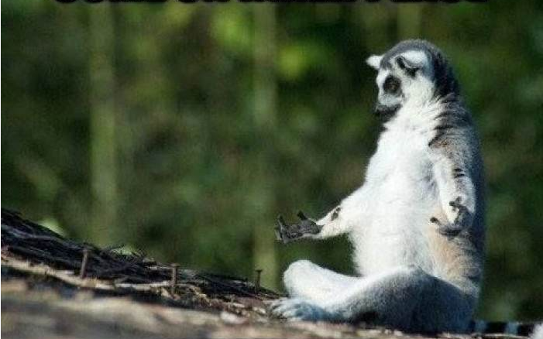
© PARADIGM PERSONALITY LABS. ALL RIGHTS RESERVED.
Patience
© PARADIGM PERSONALITY LABS. ALL RIGHTS RESERVED.
Notes:
Patient
Low intensity, very low interpretation (N2, 3- -)
High warmth (E1+)
High others needs and humility, very high agreement (A1,3+ 2++)
High drive, concentration, and methodicalness (C 3,4,5+)

Slide 33
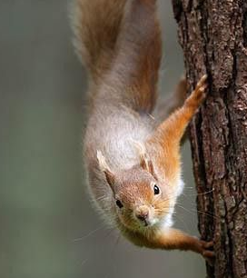
Confrontational
© PARADIGM PERSONALITY LABS. ALL RIGHTS RESERVED.
Notes:
LD Notes: If use this, maybe choose a lion instead
Confrontational
High rebound time – needs time to bounce back (N4+)
Low score on change (O3-)
Low scores on agreement, humility and reserve (A2,3,4-)

Slide 34
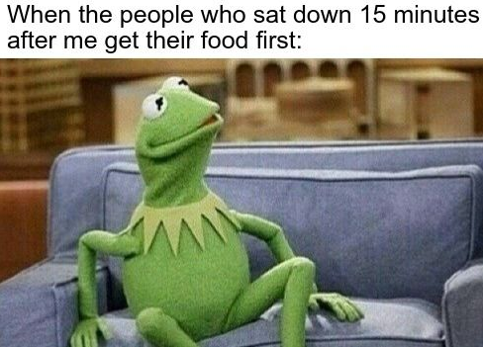
When the people who sat down 15 minutes after me get their food first:
© PARADIGM PERSONALITY LABS. ALL RIGHTS RESERVED.
Notes:
Confrontational
High rebound time – needs time to bounce back (N4+)
Low score on change (O3-)
Low scores on agreement, humility and reserve (A2,3,4-)

Slide 35
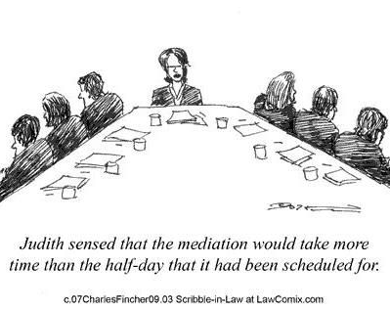
Judith senses that the mediation would take more
time than the half-day that it had been scheduled for.
© PARADIGM PERSONALITY LABS. ALL RIGHTS RESERVED.
Notes:
Conflict Adverse
Someone with high interpretation and high rebound time (N34+)
Low Sociability and low Energy mode and high trust of others (E2,3- and 5+)
High Adapter, high humility (A1,4+)

Slide 36

© PARADIGM PERSONALITY LABS. ALL RIGHTS RESERVED.
Notes:
Bold
Low worry, low rebound time (N1,4-)
High energy mode, high tact (E 3, 6+)
Low humility, low reserve (A 3, 4-)
Low methodicalness (C5-)

Slide 37

Confident
An individual that is both calm and worry-free (N1-), feels confident that they can succeed and overcome obstacles (N3-), expresses their opinion readily and comfortably in front of groups (A4-), and has high levels of perfectionism (C1+), will show up as confident.
© PARADIGM PERSONALITY LABS. ALL RIGHTS RESERVED.
© PARADIGM PERSONALITY LABS. ALL RIGHTS RESERVED.
Notes:
LD NOTES: This slide should have the same format and teach content as the previous one for Approachability.
Confident
N1,3 - -
A4 - -
C1+
N1- - Low score on worry
N3- - low score on interpretation – “things will work out in most situations” – a get back on the horse (back on the bike… etc.)
A4 – low score on reserve – comfortable in front of a room and take any opportunity to get up and talk whether prepared or not
C1+ “My work is a direct reflection of me. I take the extra time to get it 100% right. When I do make a mistake, I cringe. I expect the same from others.”

Slide 38

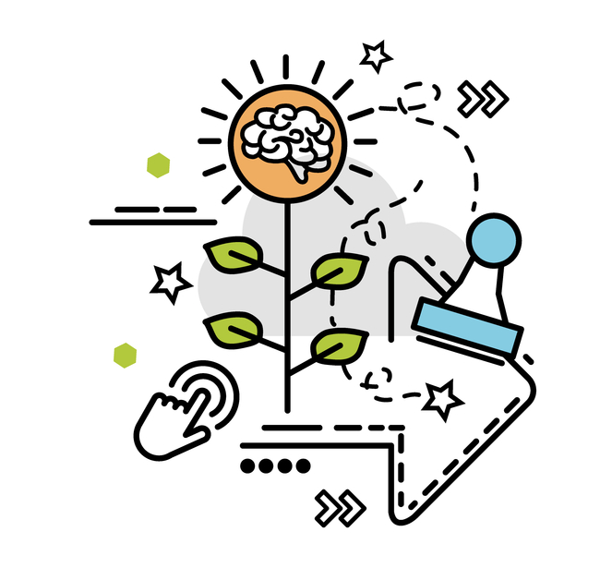
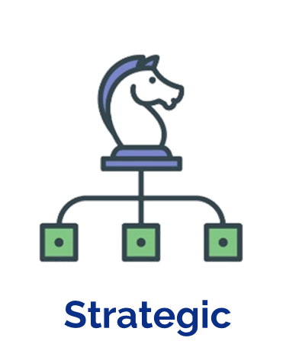
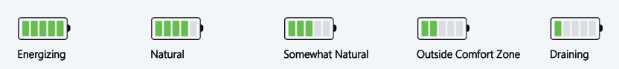
Vision
Strategic
Enjoys creating the compelling strategic vision that spurs sustained organizational action.
Prefers focus on longer-term strategic horizons rather than day-to-day operational details.
Aligns vision, capabilities, and anticipated market needs to drive the business forward.

Slide 39
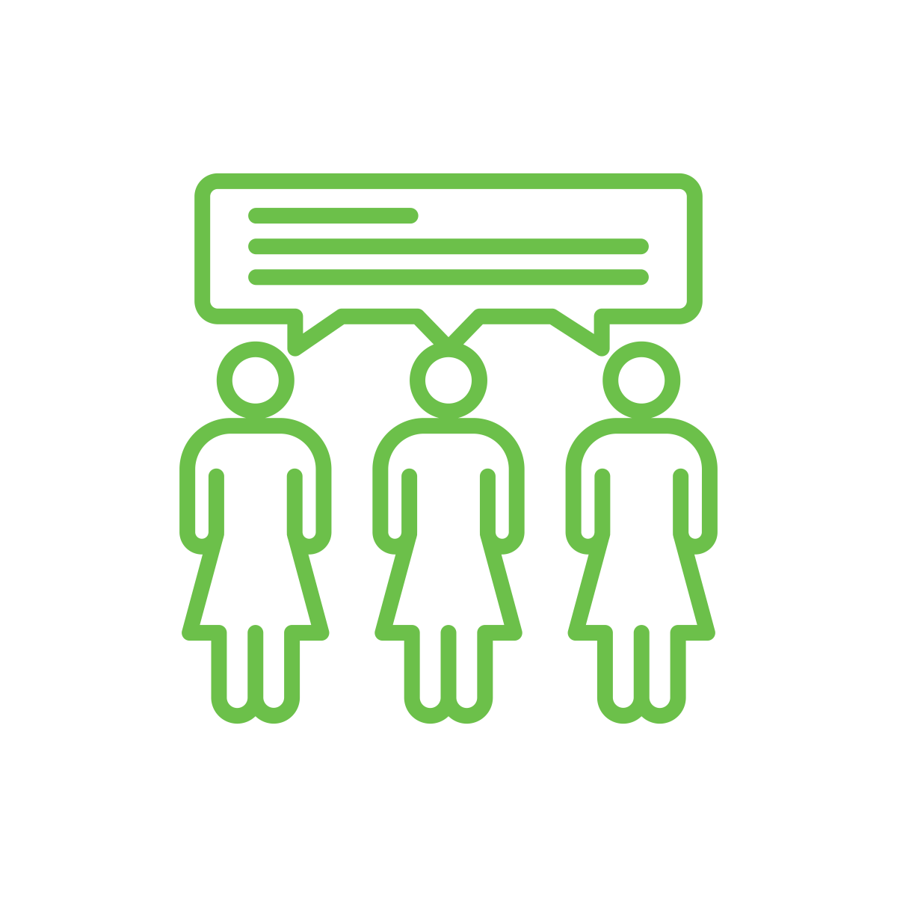
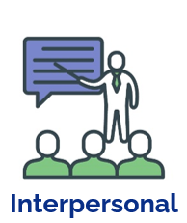
Effective Communication
Interpersonal
Cares about the precision and subtlety of clear written and spoken communication.
Listens objectively and knows how to facilitate mutual understanding across different contexts.
Advocates for high-quality communication in internal and client relationships.

